Slide 1












Aquamarine
Kelompok 6 :
Fundroo Orlando - 535200074
Gloria Valerie Lao - 535200049
Michelle Augustine - 535200055
Tiffany - 535200057
Stevenson Tjuaca- 535200067

Slide 2



01
Fitur dan Layout

Slide 3

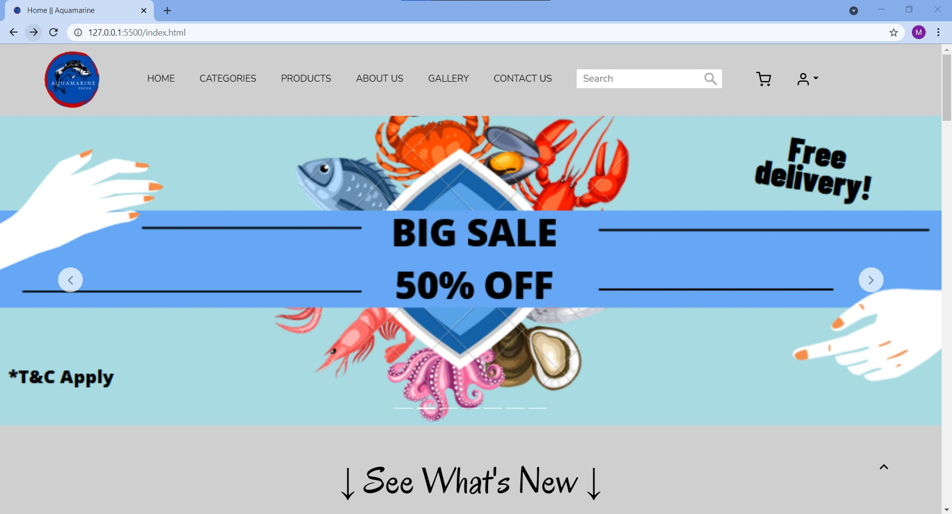
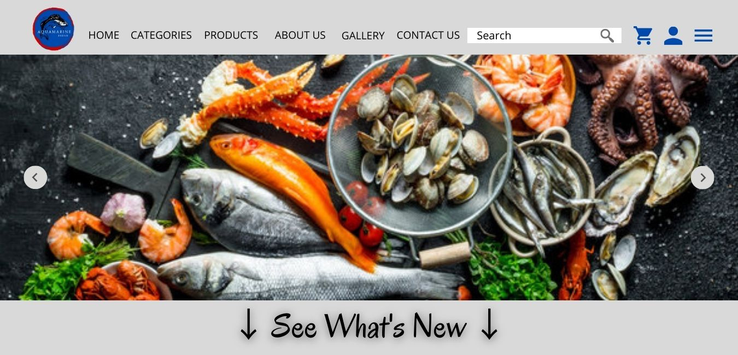
Halaman Home
Design
Web
Warna icon Cart dan Profile ganti dari biru jadi hitam
Pada Carousel ada tambahan yaitu terdapat 7 garis dibawah
Tambahan slide baru berupa Big Sale untuk event-event tertentu

Slide 4


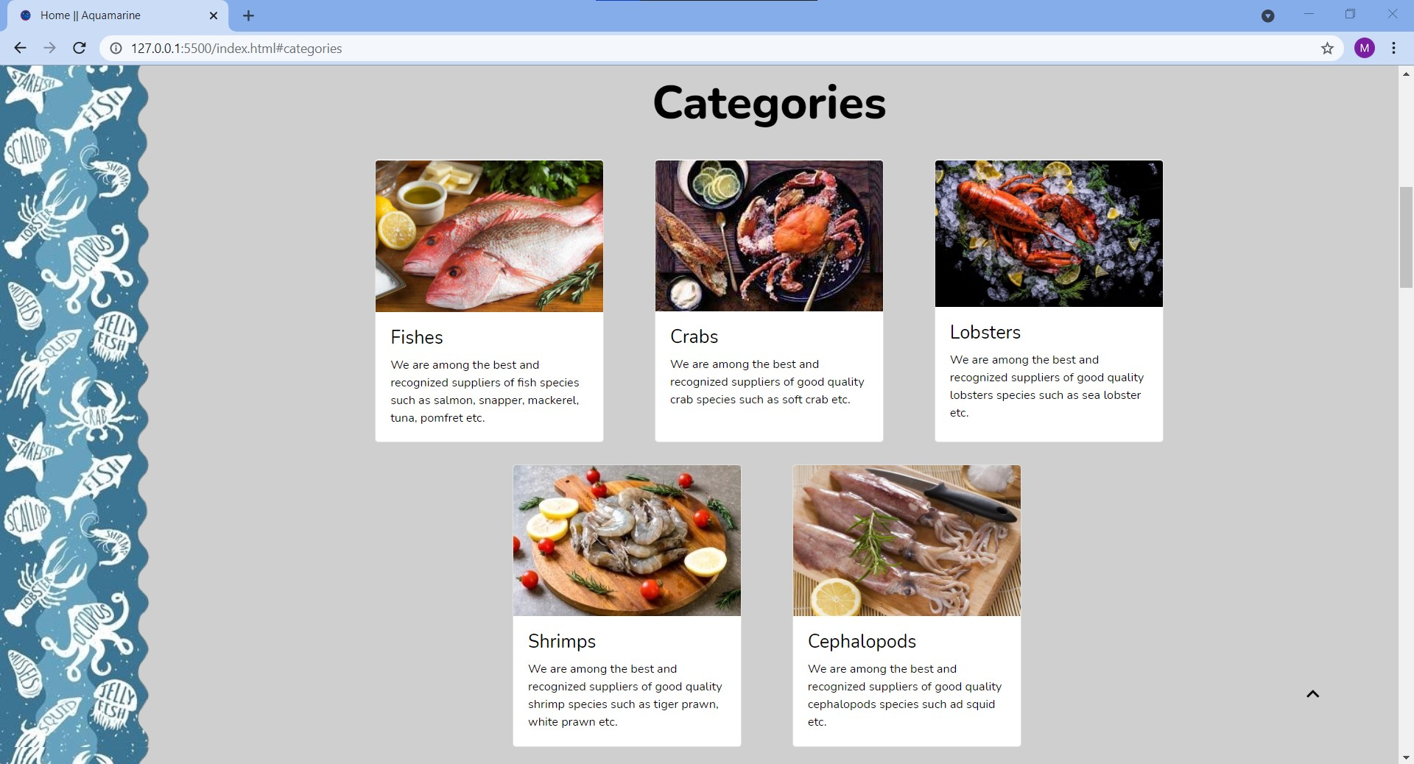
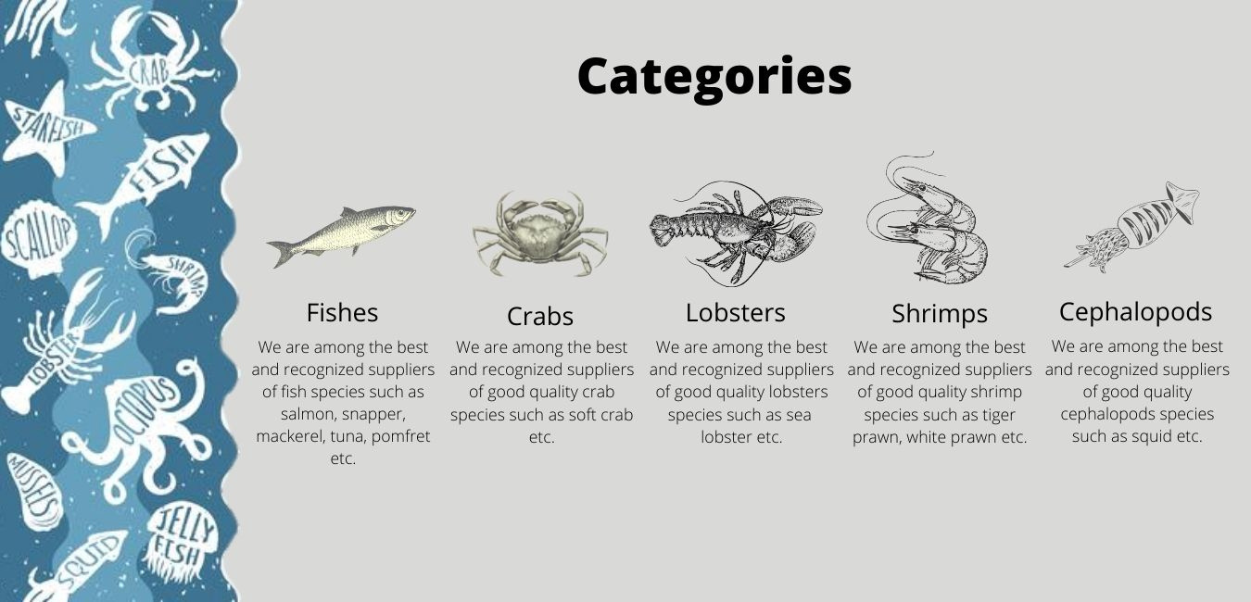
Halaman Categories
Design
Web
Beda layoutnya dengan design : ditambahkan box
Beda susunan posisi dari kategorinya
Beda gambarnya dengan design : menggunakan gambar asli lebih menarik

Slide 5

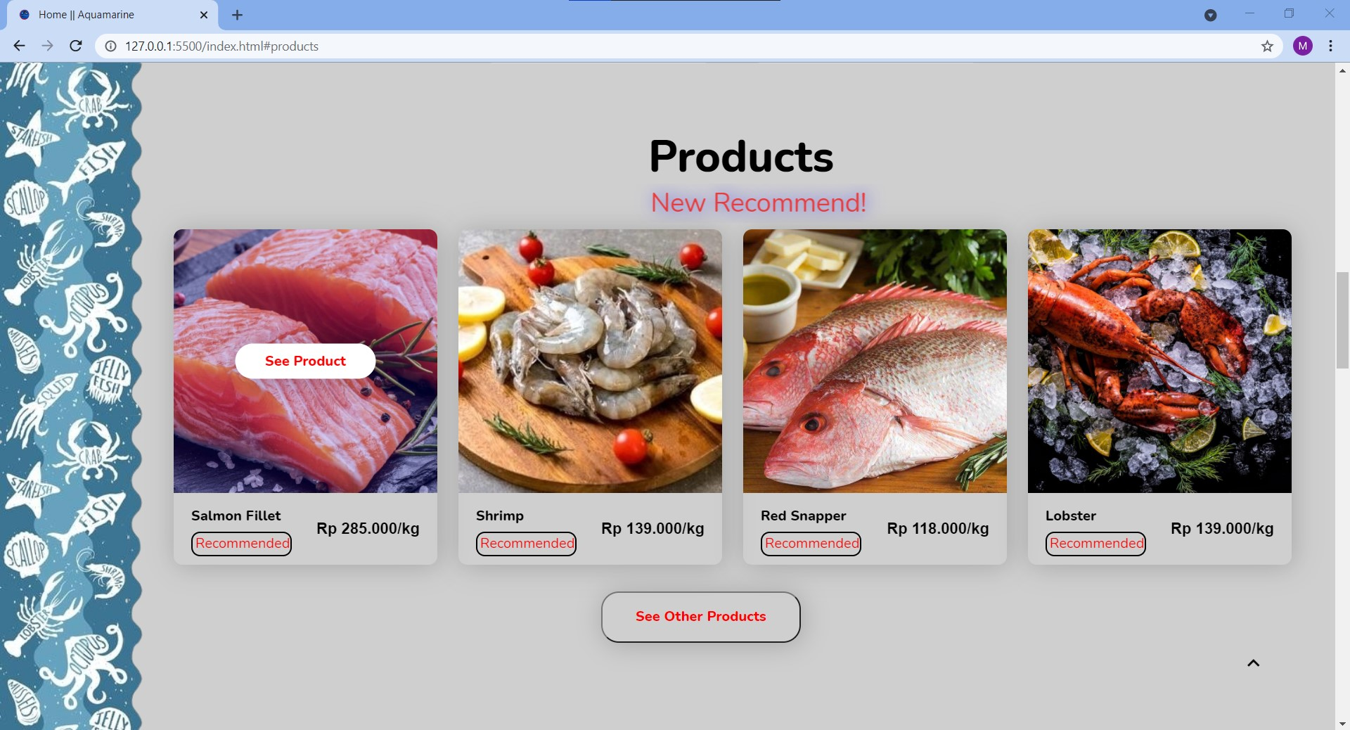
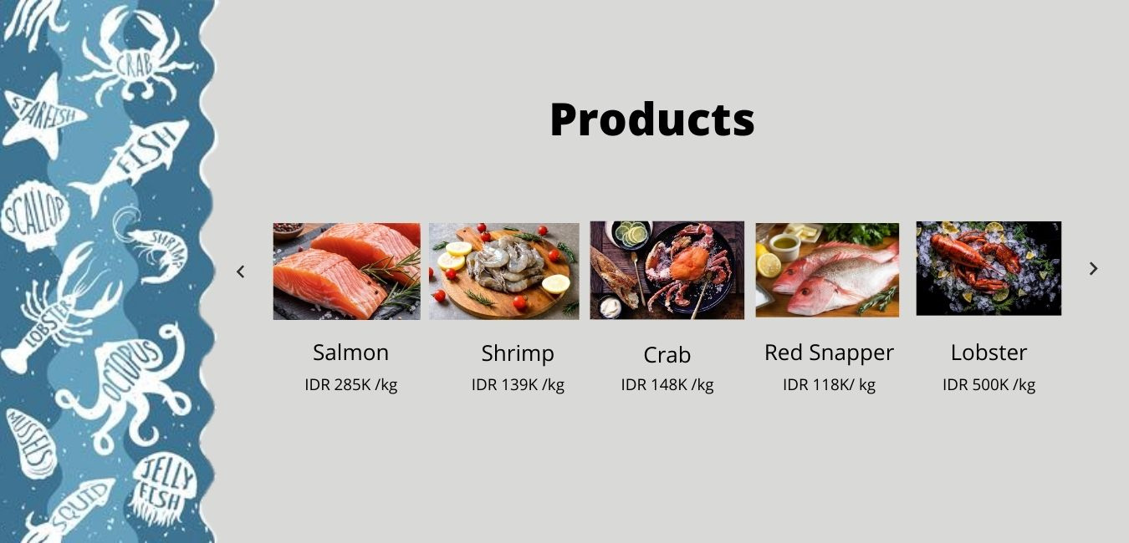
Halaman Products
Design
Web
Beda layoutnya dengan design : ditambahkan box dan gambar lebih besar
Menampilkan tulisan New Recommend! yang interaktif di bawah title Products dan Recommended dari produk-produk yang ditampilkan
Carousel diganti dengan tambahan button See Other Products dibawah

Slide 6
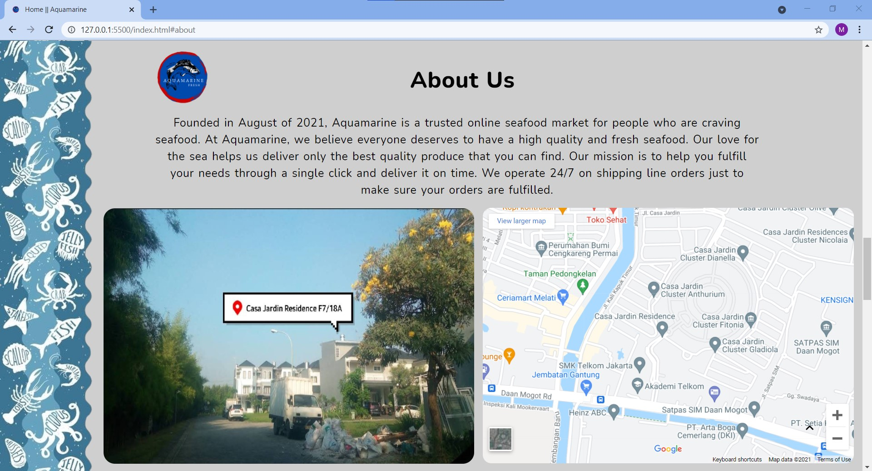
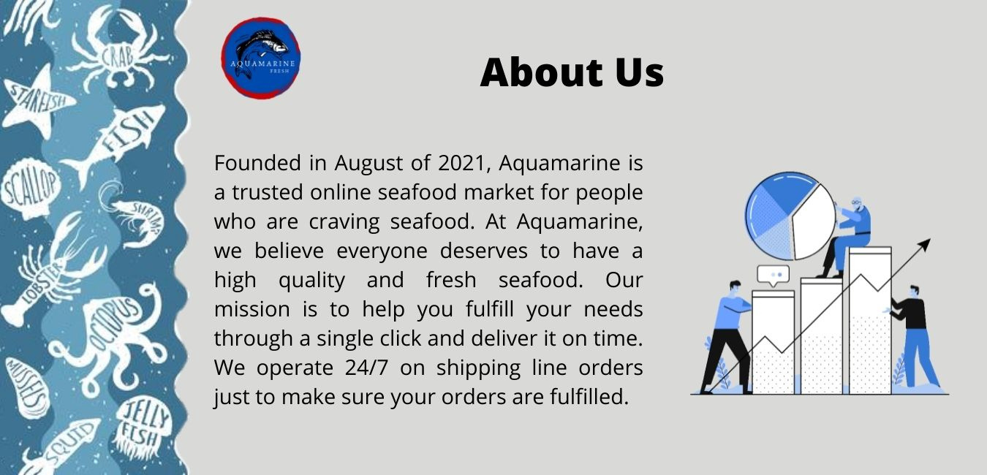
Halaman About Us
Design
Web
Letak paragraf berubah dari kiri ke tengah
Gambar pada design diganti dengan gambar bangunan asli dan map dari lokasi perusahaan

Slide 7
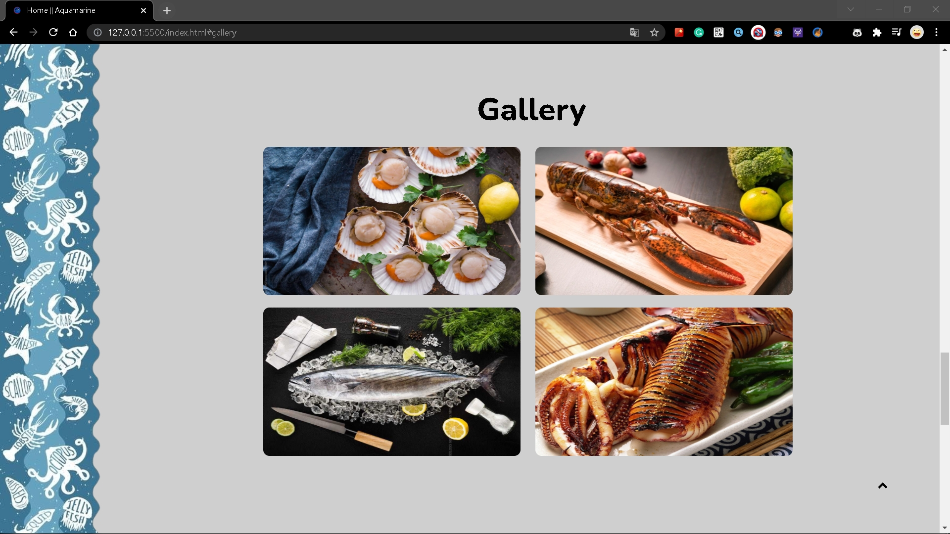

Halaman Gallery
Design
Web
Untuk gambarnya ada sedikit perubahan yaitu dari yang awalnya berjumlah 3 gambar menjadi 4 gambar
Ditambahkan sedikit border pada sudut gambar.

Slide 8
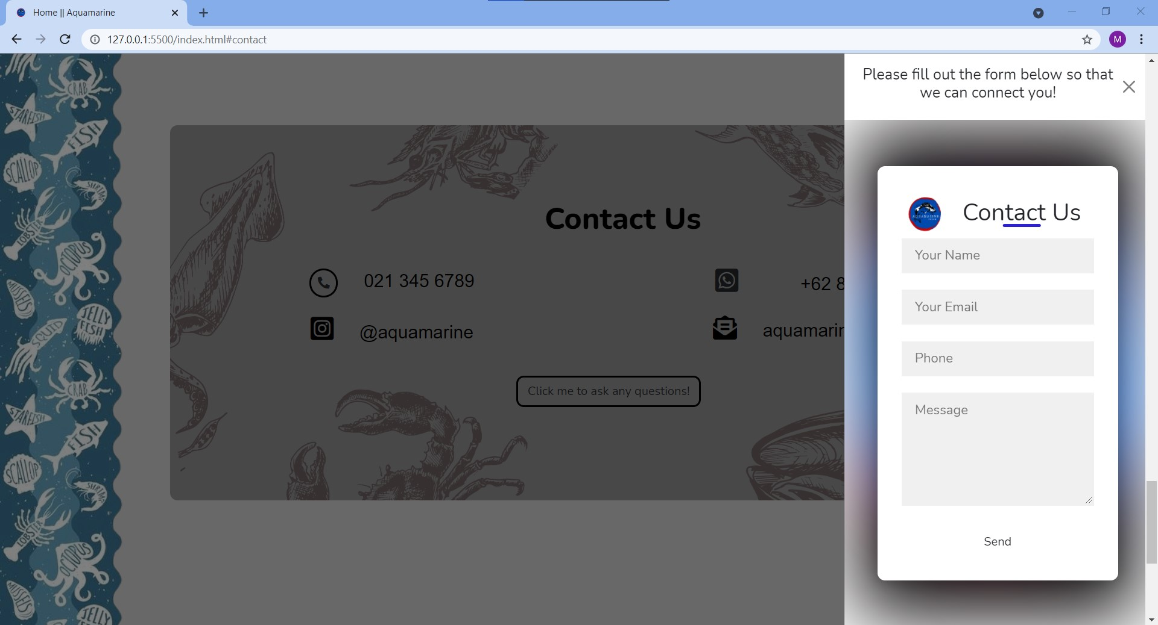


Halaman Contact Us
Design
Web
Beda layoutnya dengan design : ditambahkan box
Pada nomor WhatsApp, diganti dengan format +62
Terdapat button Click me to ask any questions! yang jika diklik akan muncul form yang berada di kanan

Slide 9
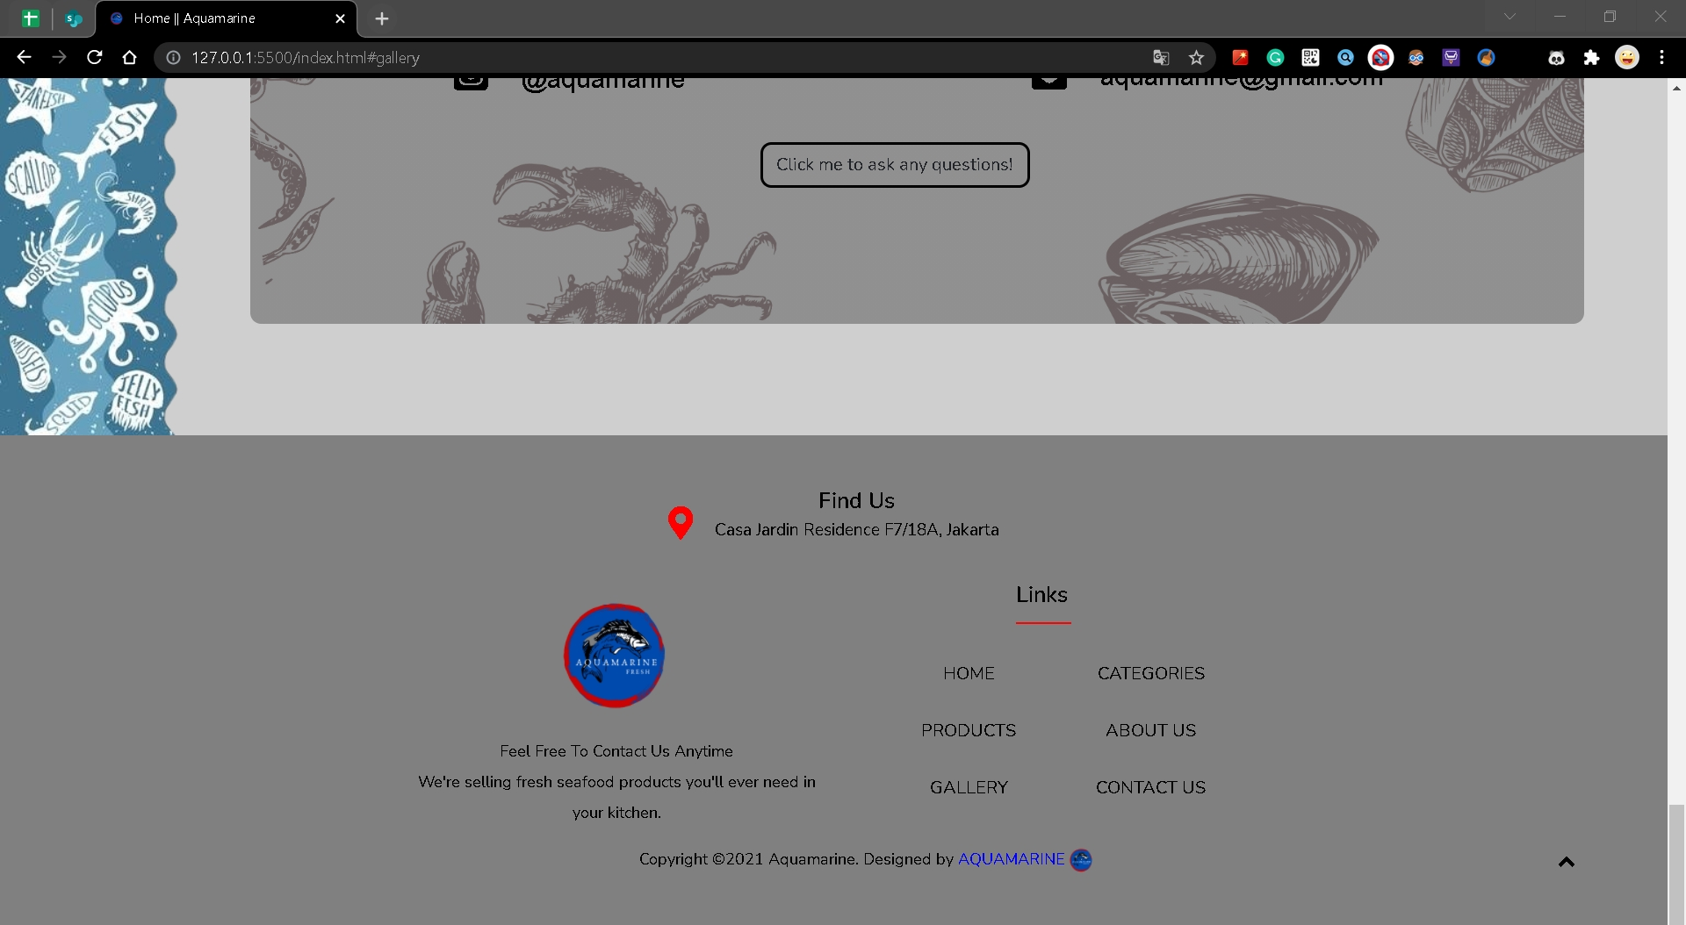
Halaman Footer

Slide 10
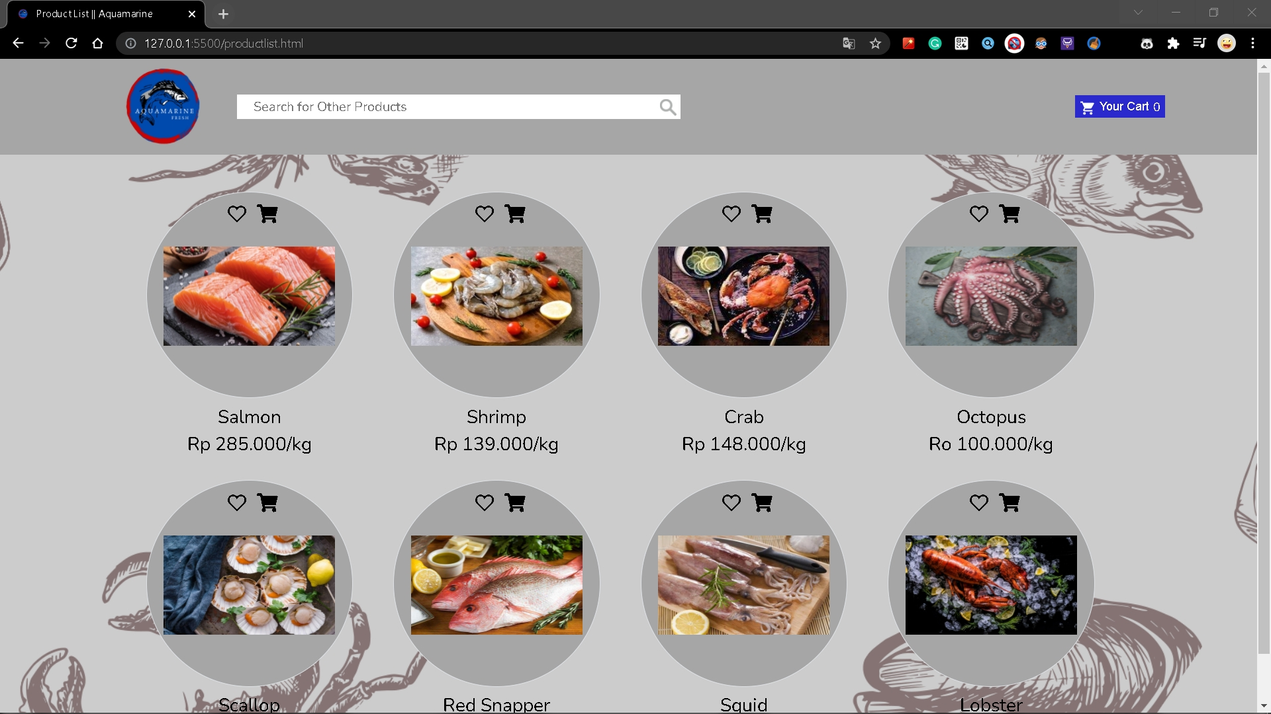
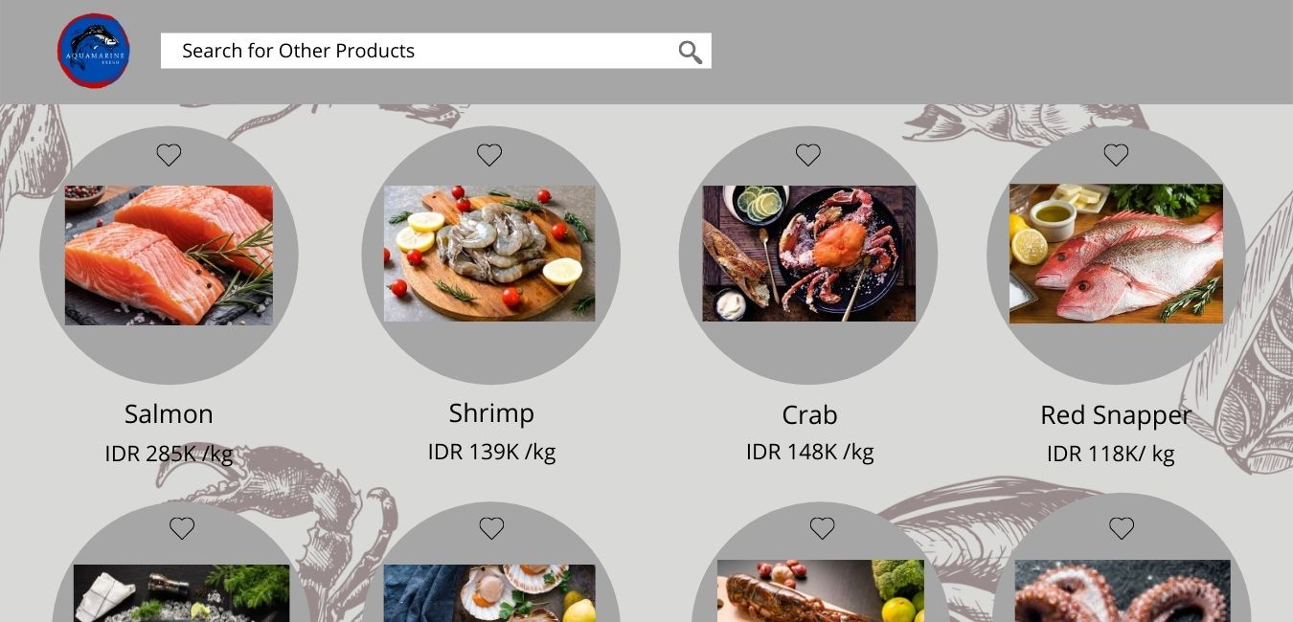
Halaman Products List
Design
Web
Tambah button Cart disebelah button Wish List
Tambah button Your Cart di sudut kanan

Slide 11
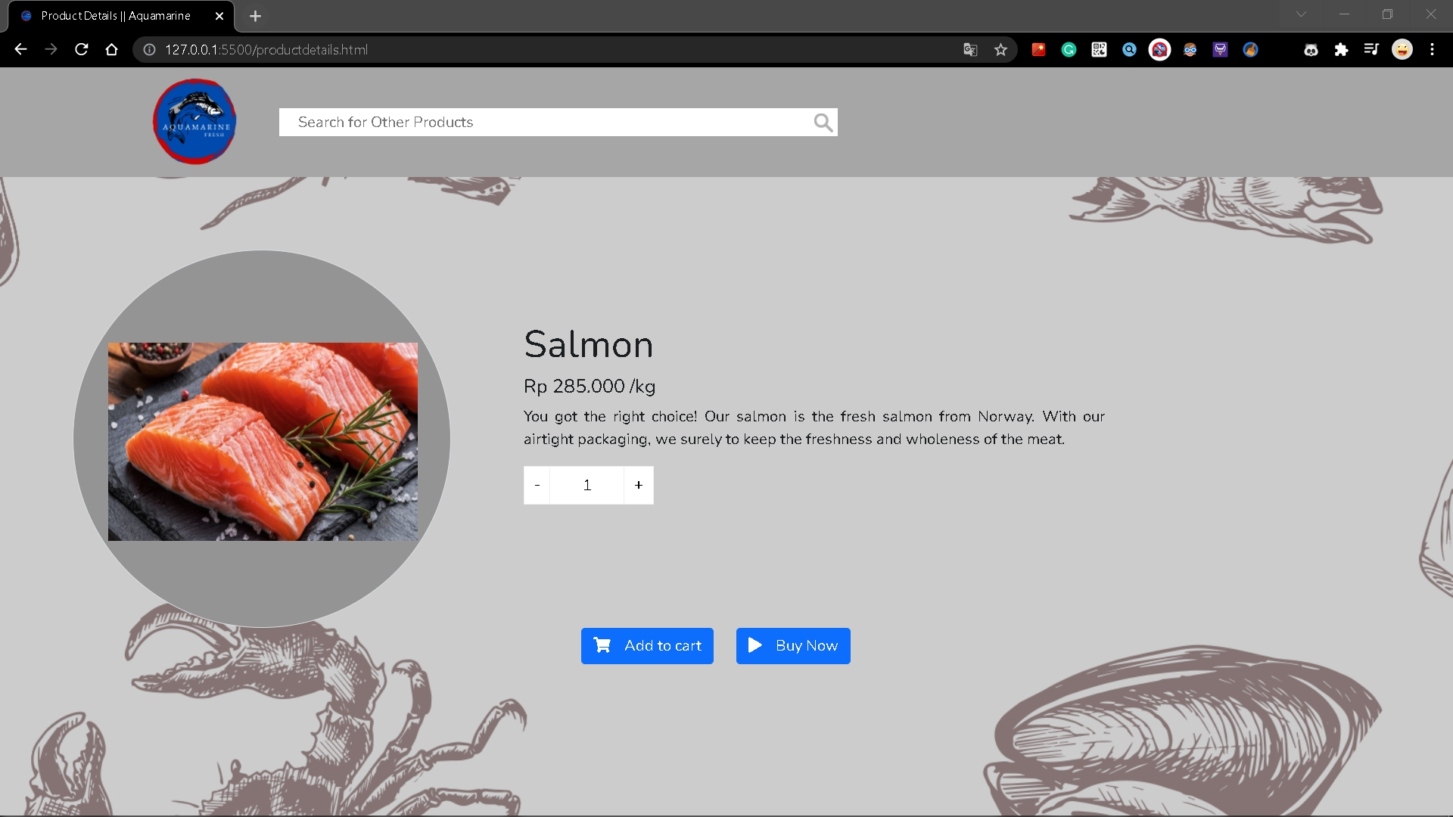
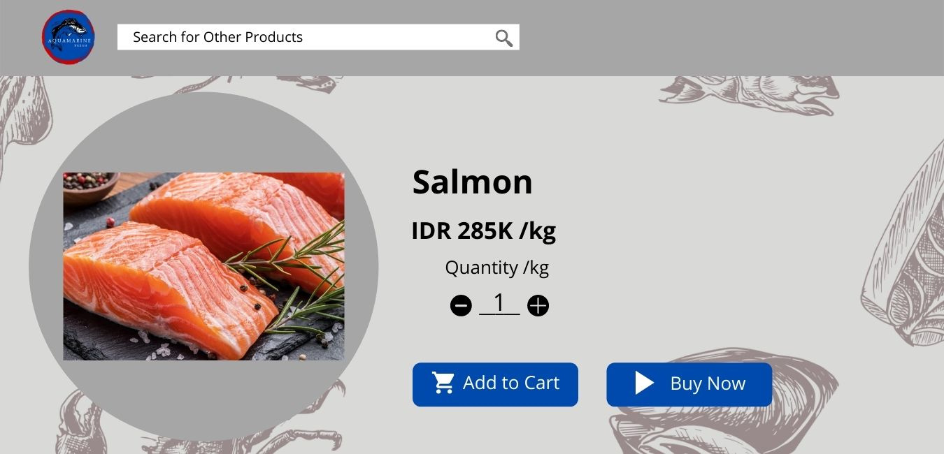
Halaman Product Details
Design
Web
Page setiap produk
Tambah deskripsi singkat mengenai produk
Bentuk dari - + beda dari design

Slide 12
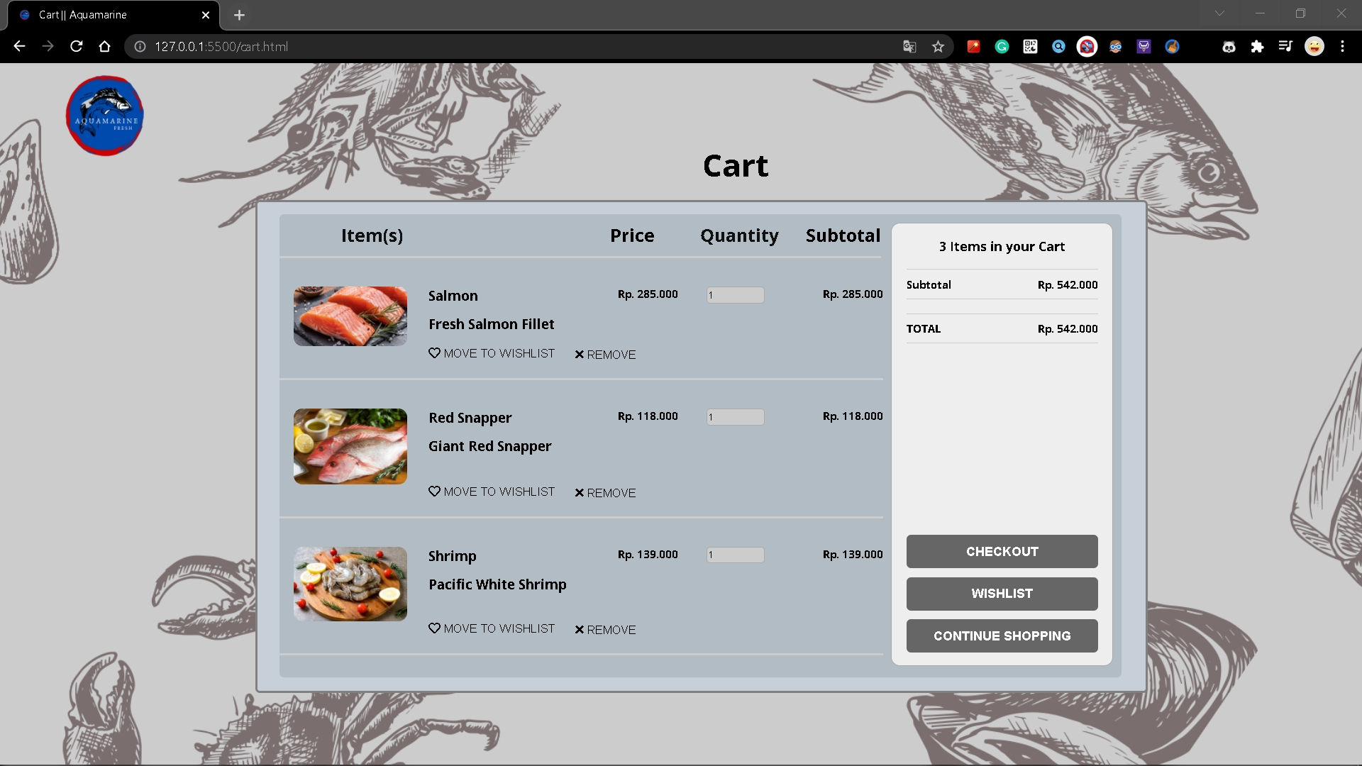
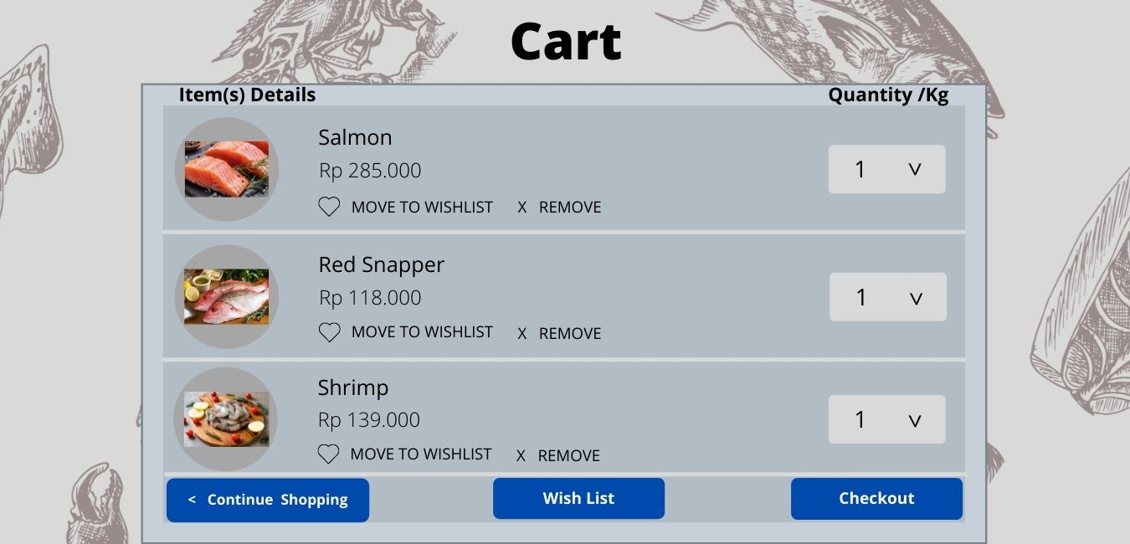
Halaman Cart
Design
Web
Terdapat logo dikiri atas
Tambah Subtotal dari harga masing-masing produk
Tambah deskripsi singkat dari produk
Quantity bisa di adjust naik (tambah), turun (kurang)
Tambah Box Item Total dikanan
Perpindahan letak button dari bawah ke samping

Slide 13


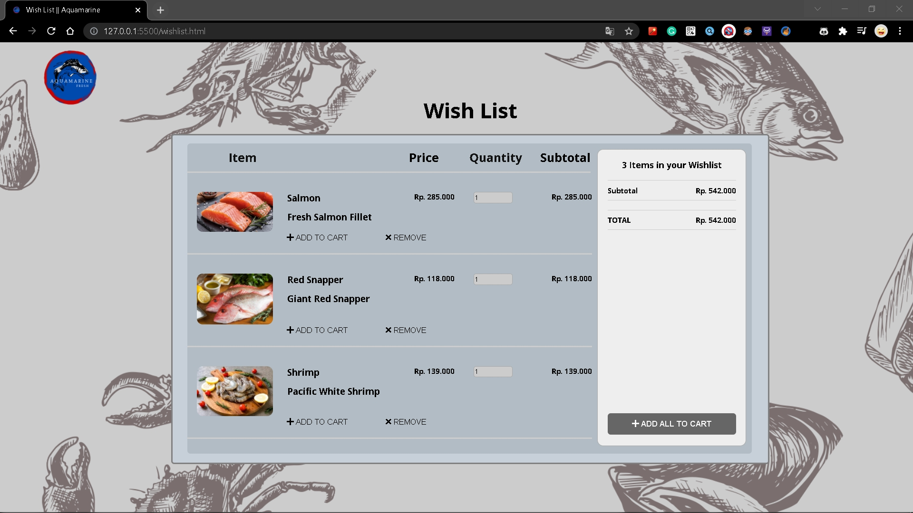
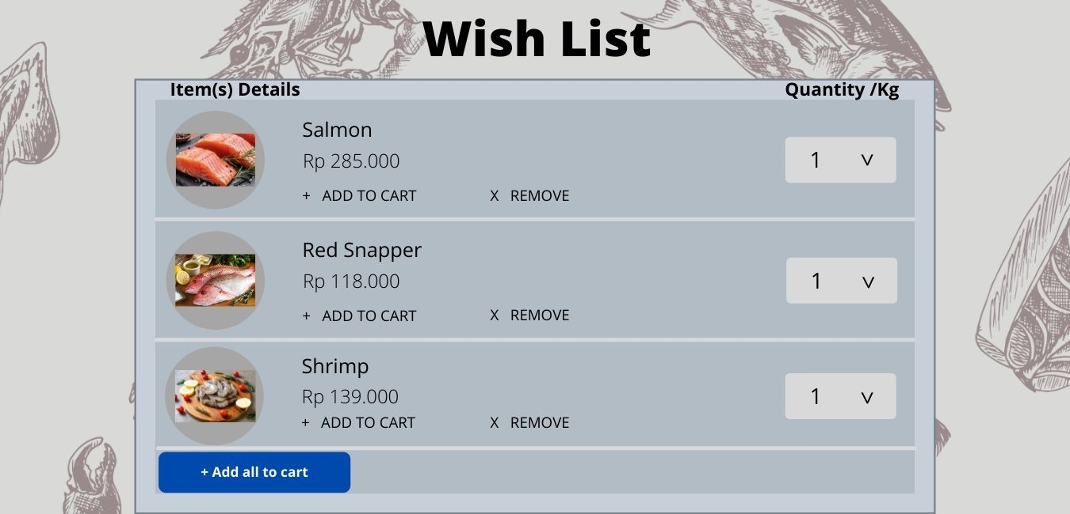
Halaman Wish List
Design
Web
Terdapat logo dikiri atas
Tambah Subtotal dari harga masing-masing produk
Tambah deskripsi singkat dari produk
Quantity bisa di adjust naik (tambah), turun (kurang)
Tambah Box Item Total dikanan
Perpindahan letak button dari bawah ke samping

Slide 14
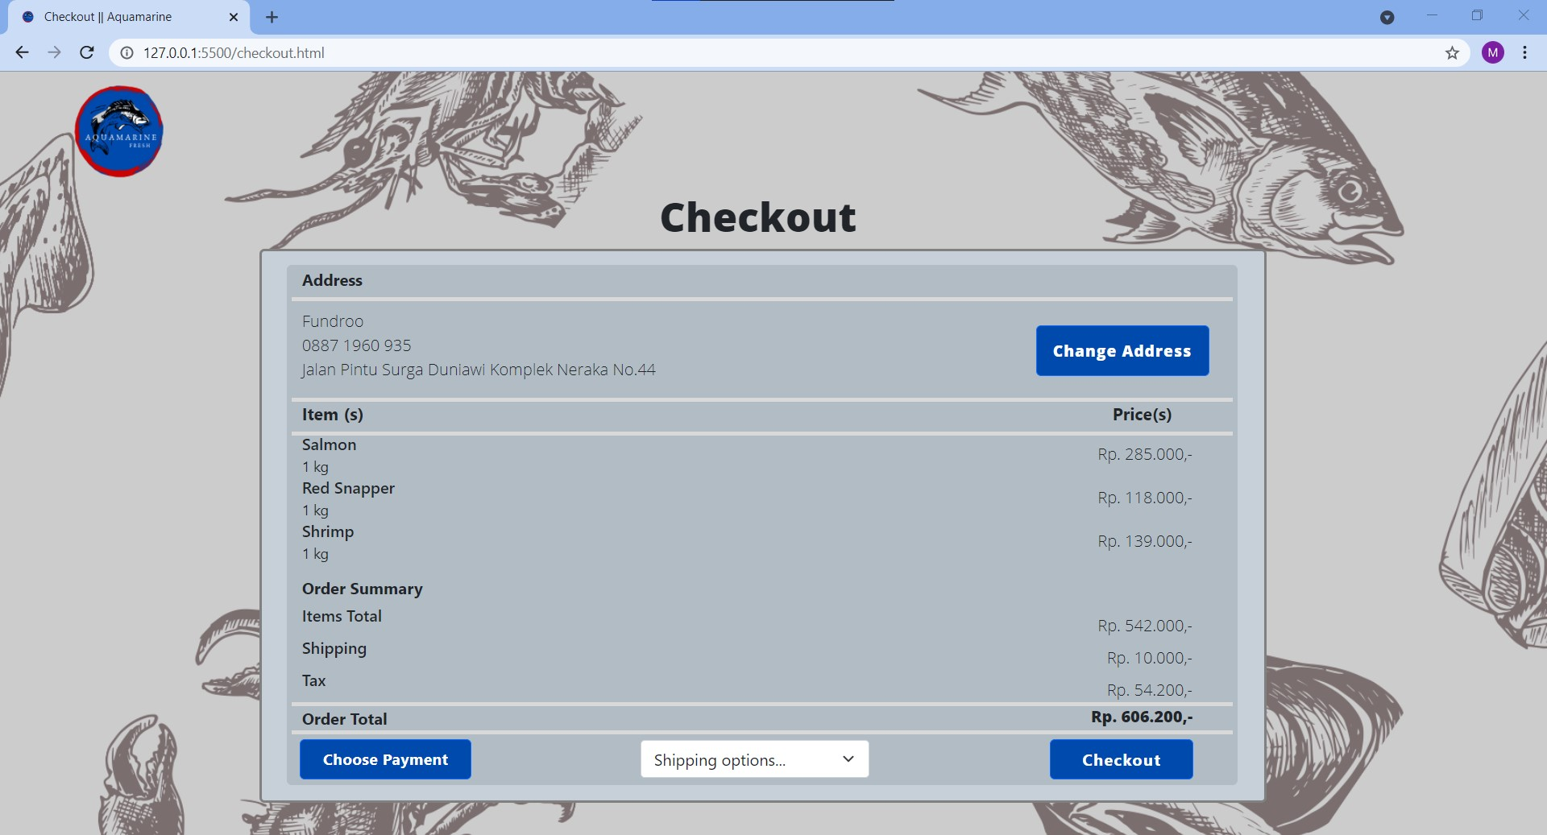
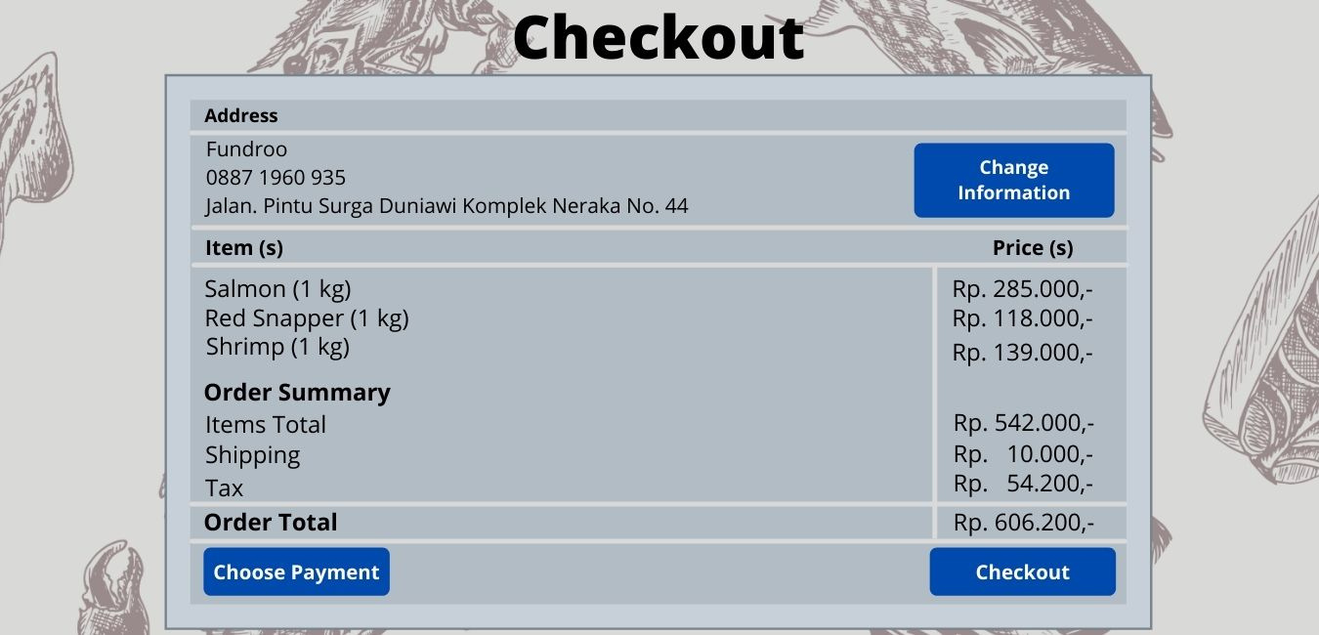
Halaman Checkout
Design
Web 1
Terdapat logo dikiri atas
Button Change Information menjadi Change Address
Terdapat list dropdown berisi pilihan pengiriman serta harganya

Slide 15
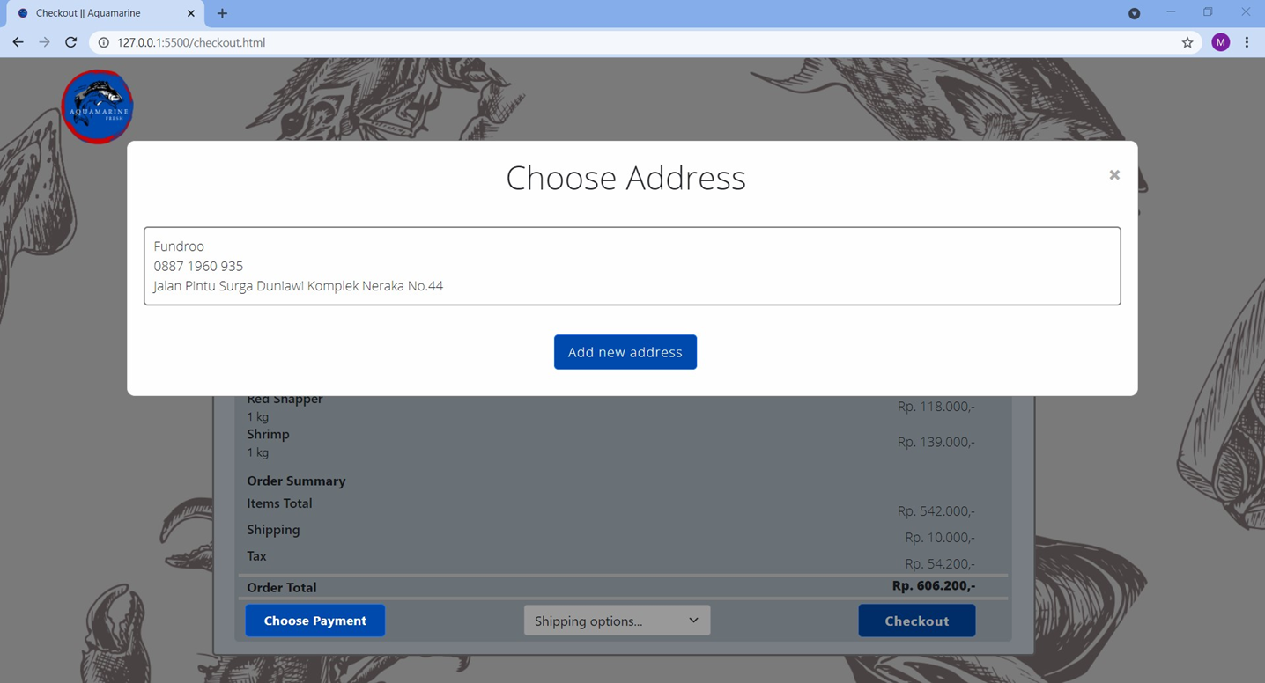
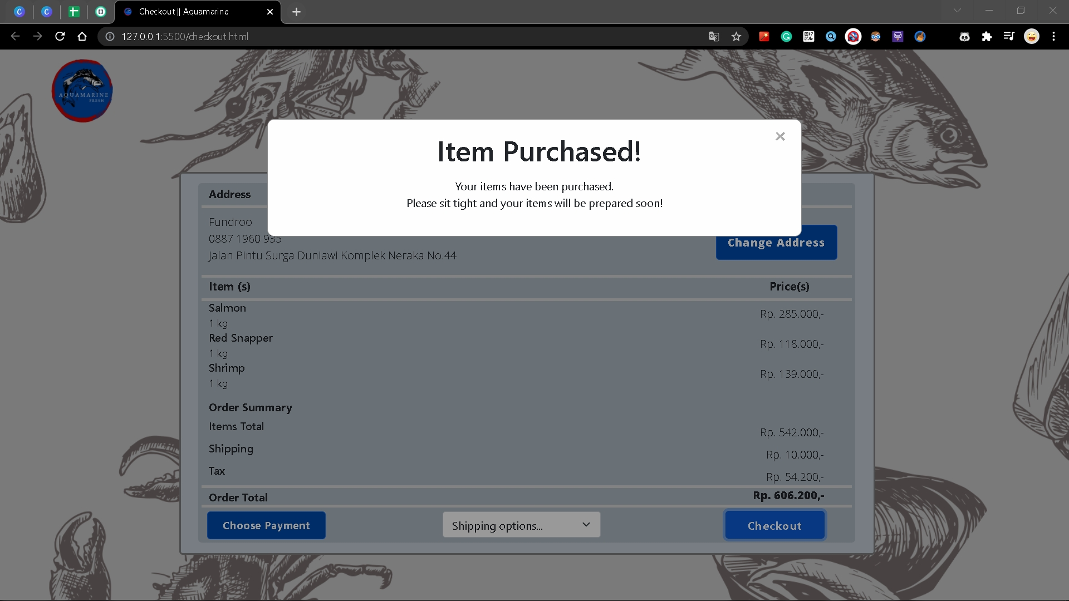
Halaman Checkout
Web 2
Web 3
Pada button Change Address ketika diklik akan muncul tampilan pop up seperti pada Web 2
Saat button Checkout diklik maka akan muncul tampilan pop up seperti pada Web 3

Slide 16
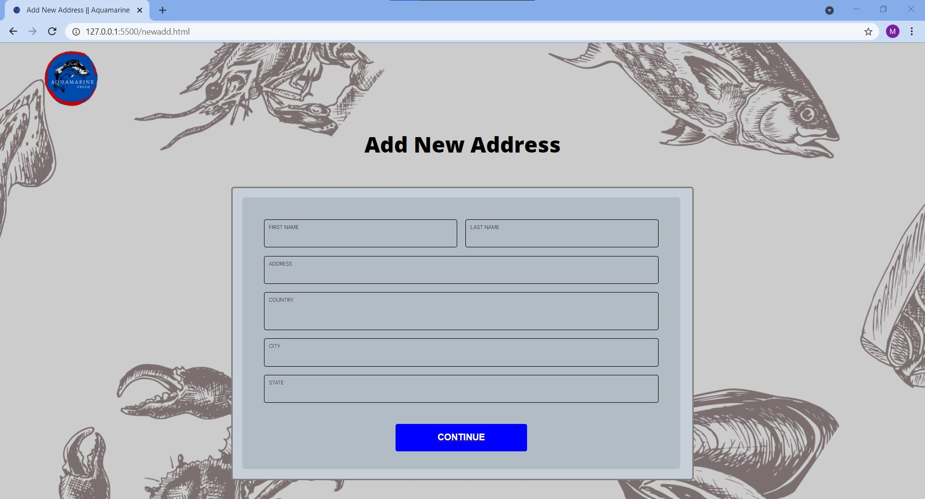
Halaman New Address

Slide 17
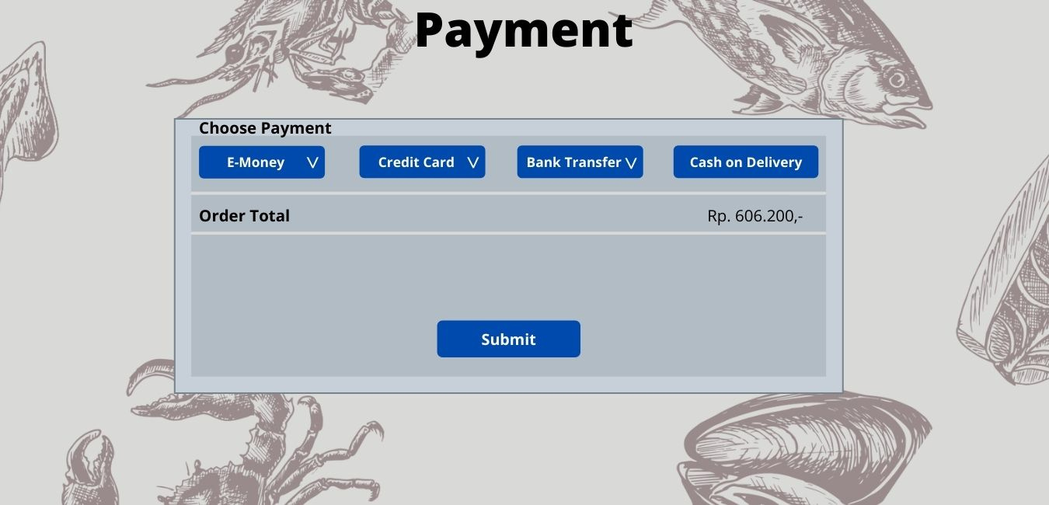
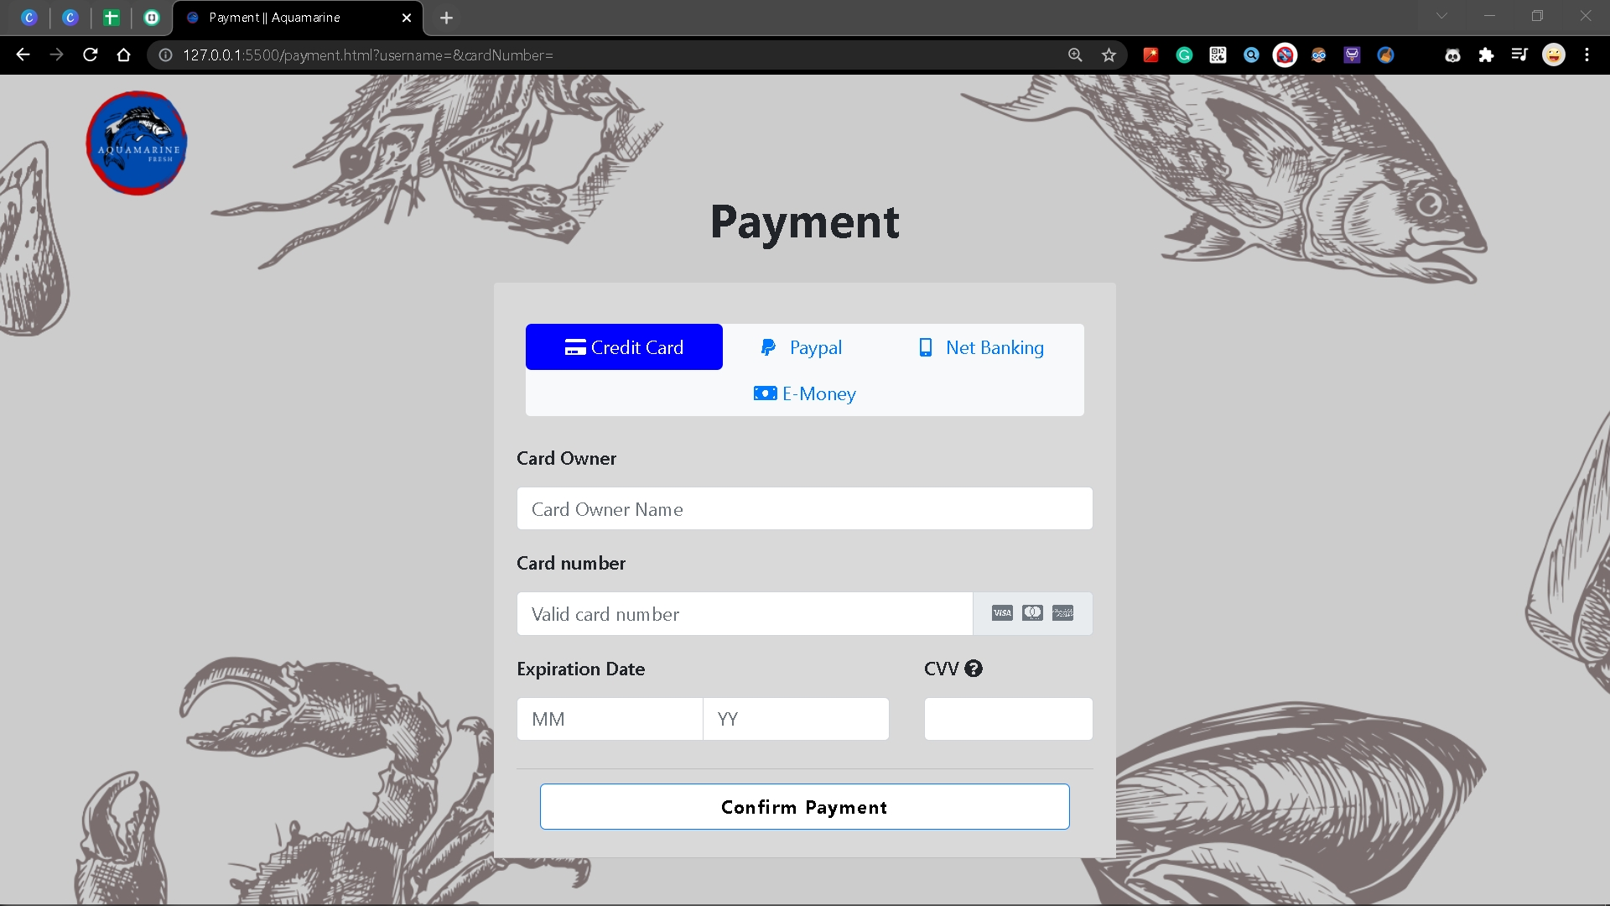
Halaman Payment
Design
Web
Terdapat logo dikiri atas
Terdapat perbedaan layout dengan design
Pada halaman awal sudah berada di pilihan Credit Card
Order total dihapus

Slide 18
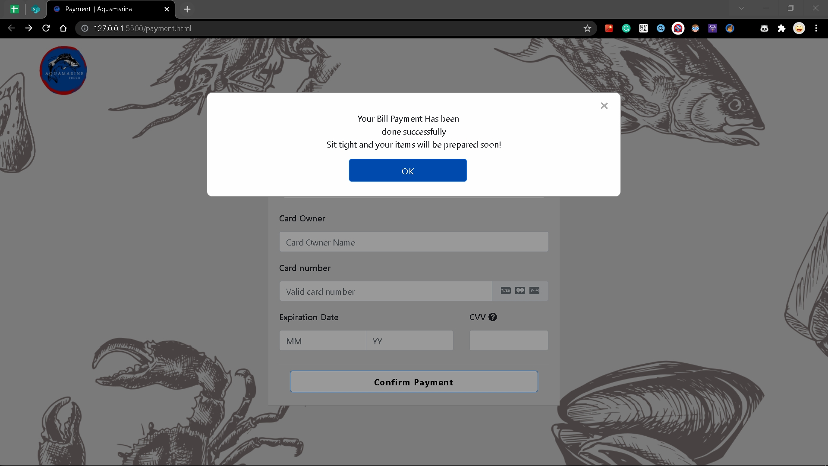
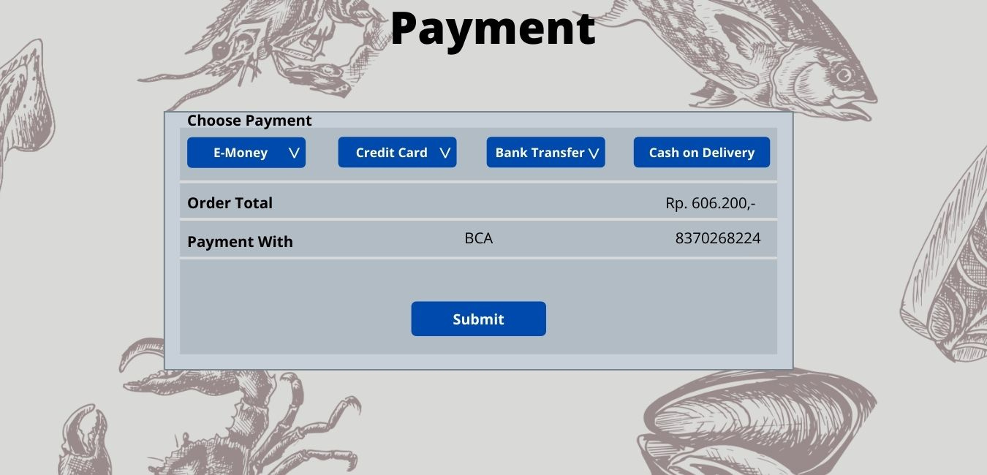
Halaman Payment Credit Card
Design
Web
Terdapat perbedaan layout dengan design, logo berada di kiri atas
Order total dihapus
Langsung input data Credit Card dengan form yang tersedia
Button Submit diubah menjadi Confirm Payment dan saat di klik akan muncul pesan pop up

Slide 19
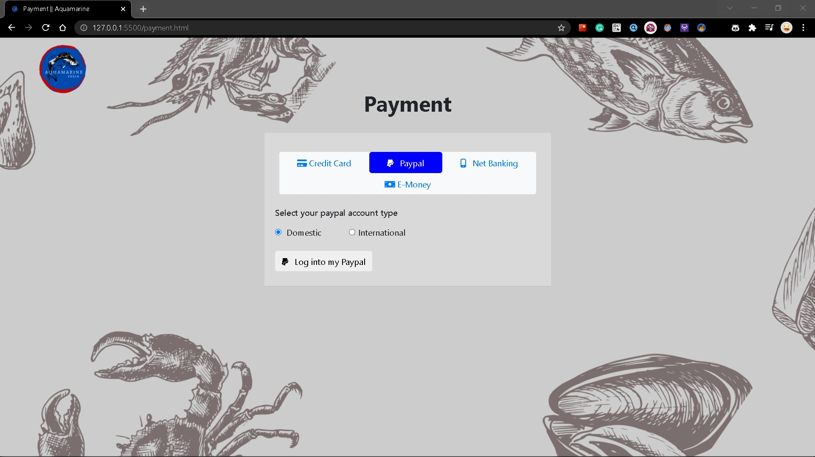
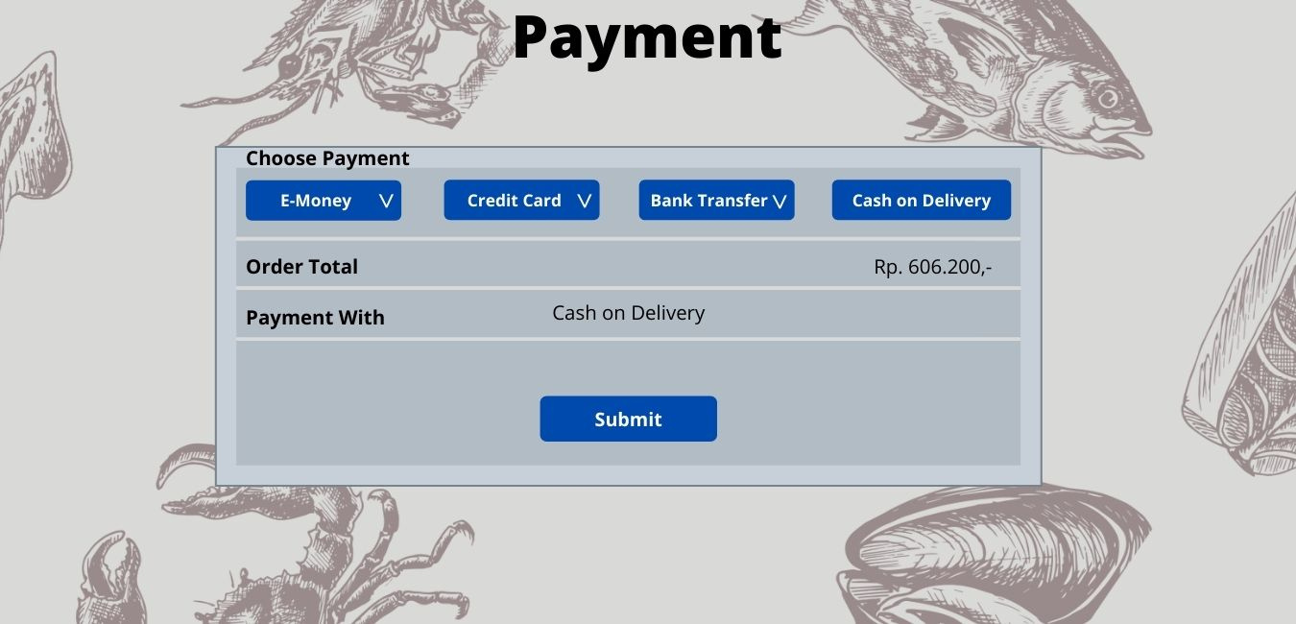
Halaman Payment Paypal
Halaman Payment Paypal
Design
Web
Terdapat logo dikiri atas
Terdapat perbedaan layout dengan design
Order total dihapus
Pilihan COD diganti Paypal
Terdapat pilihan Paypal Account Type
Button Submit diubah menjadi Log into my Paypal

Slide 20
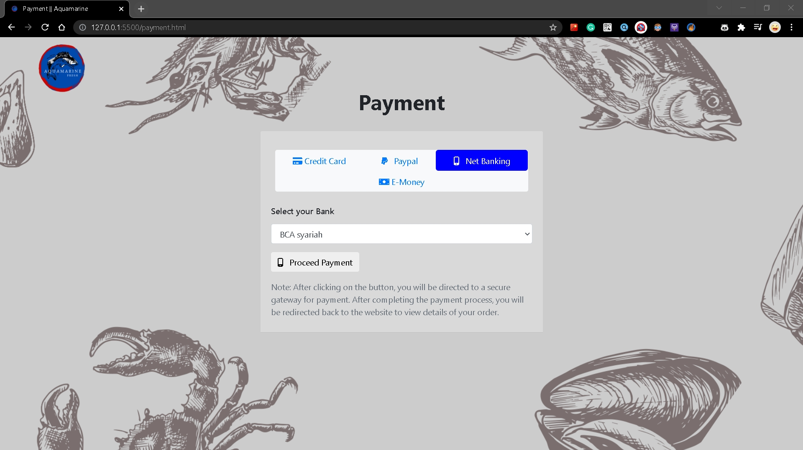

Halaman Payment Net Banking
Design
Web
Terdapat logo dikiri atas
Terdapat perbedaan layout dengan design
Order total dihapus
Pilihan Bank Transfer diubah nama menjadi Net Banking
Button Submit diubah menjadi Proceed Payment
Terdapat text berisi Note

Slide 21
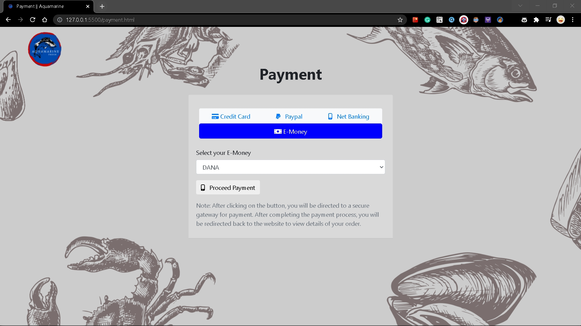
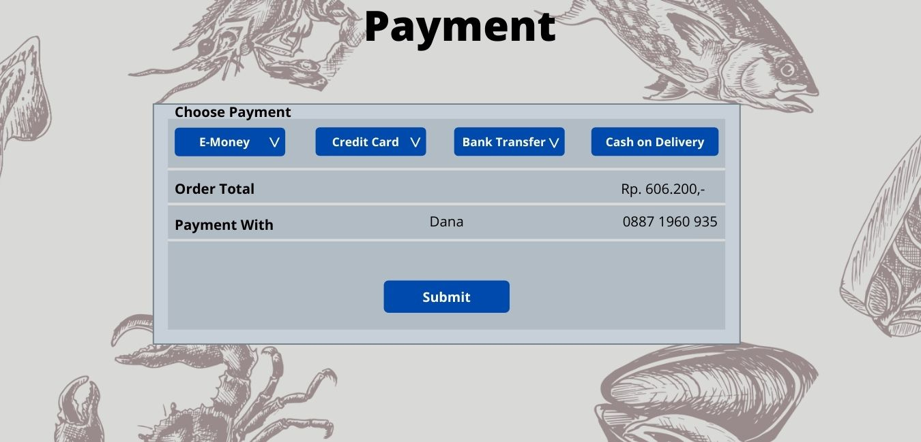
Halaman Payment E-Money
Design
Web
Terdapat logo dikiri atas
Terdapat perbedaan layout dengan design
Order total dihapus
Button Submit diubah menjadi Proceed Payment
Terdapat text berisi Note

Slide 22
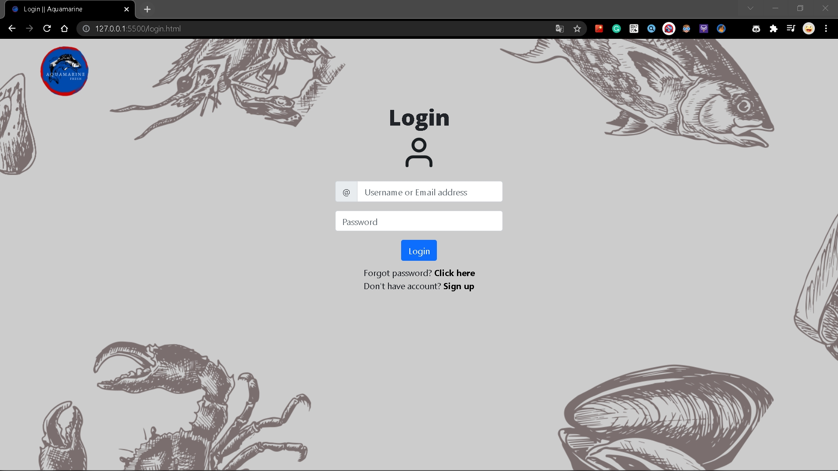
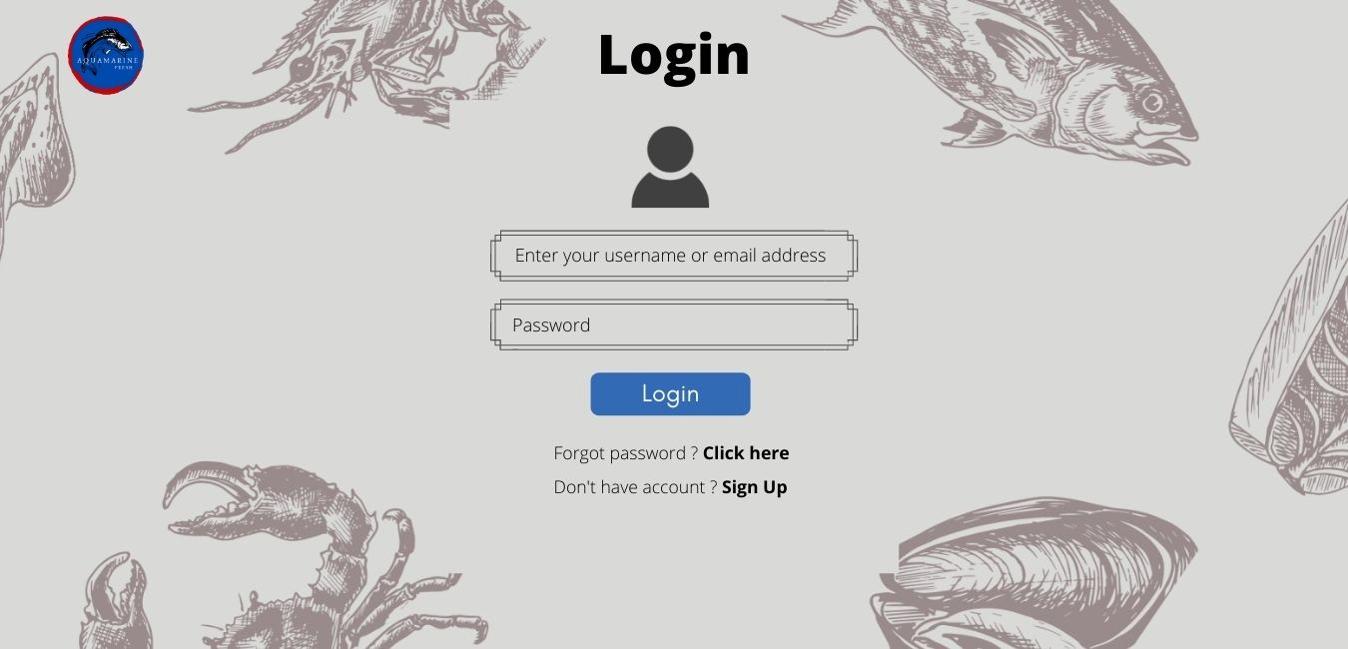
Halaman Login
Design
Web
Terdapat perbedaan layout dengan design yaitu dibagian input boxnya

Slide 23
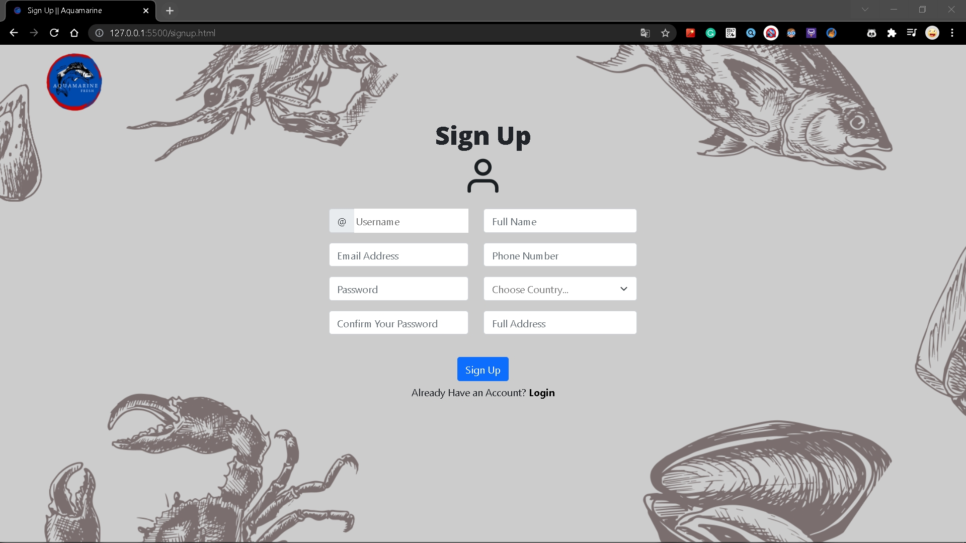
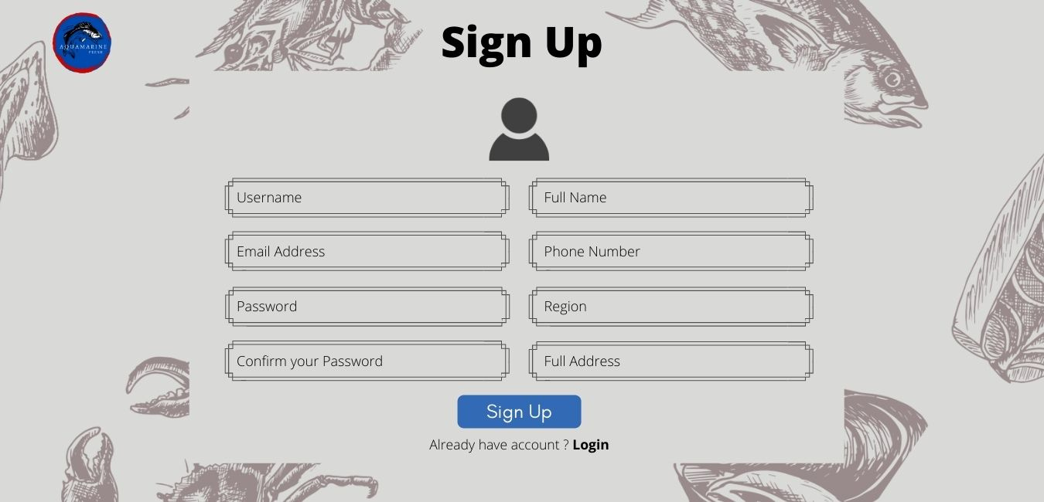
Halaman Sign Up
Design
Web
Terdapat perbedaan layout dengan design yaitu dibagian input boxnya
Region diubah menjadi Choose Country

Slide 24
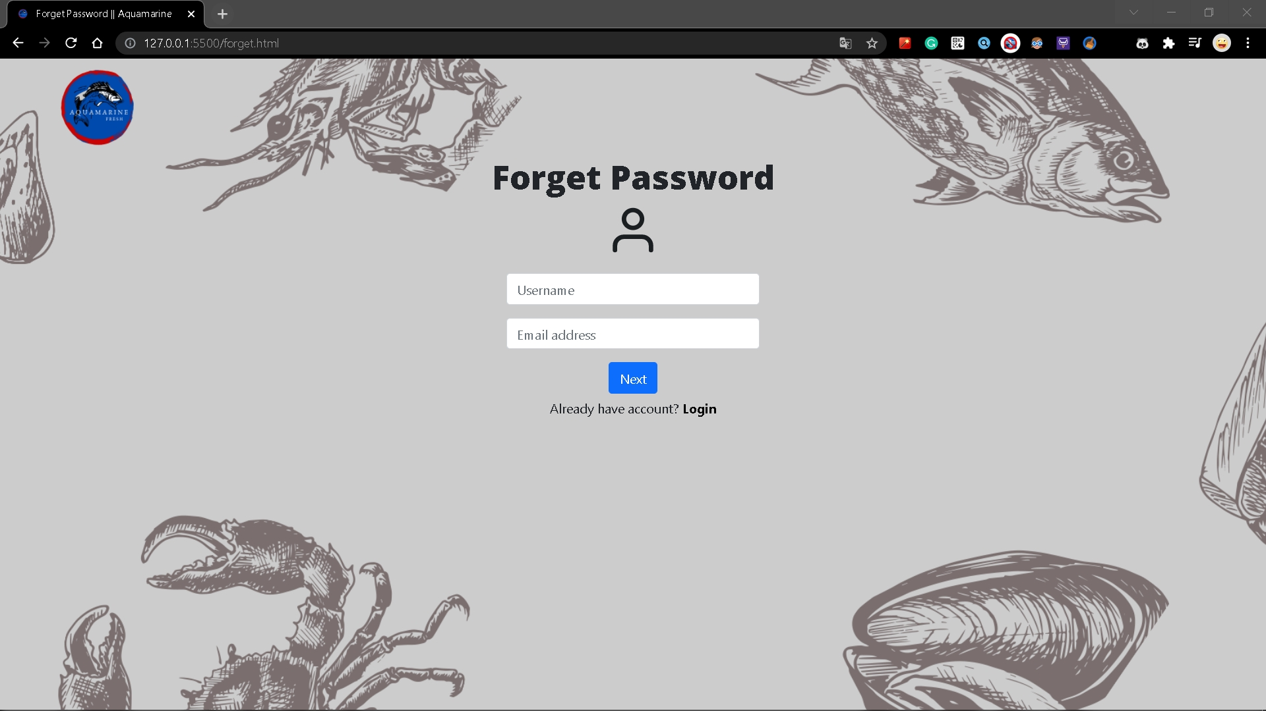
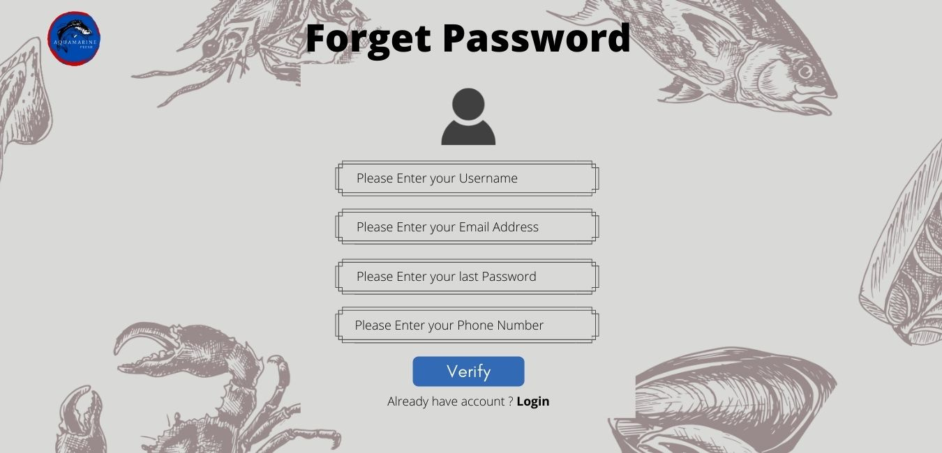
Halaman Forget Password 1
Design
Web
Last Password dan Phone Number dihapus
Button Verify diubah menjadi Next
Perbedaan layout pada input box

Slide 25
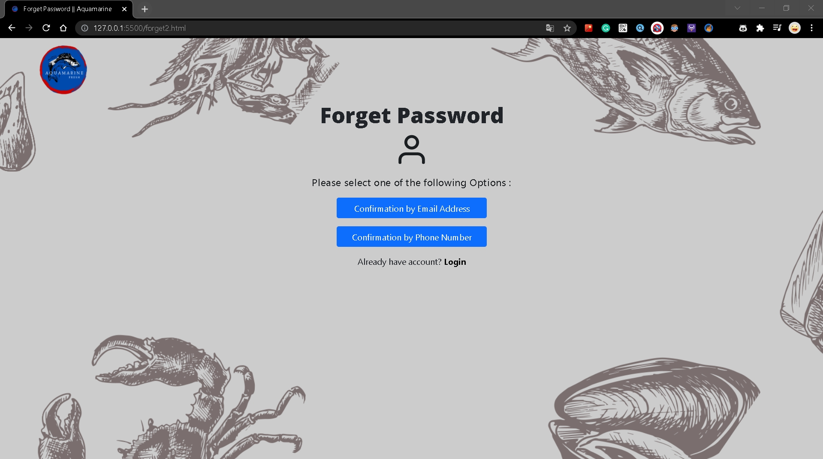
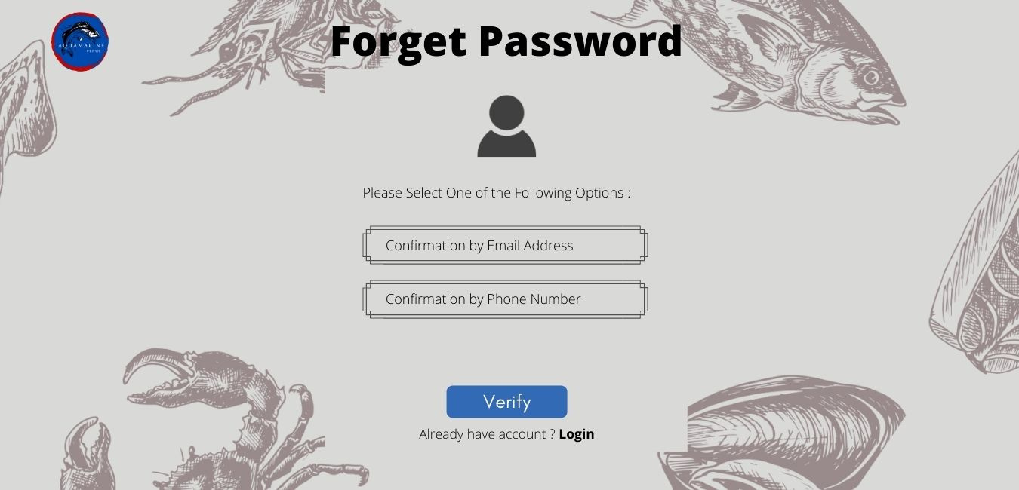
Halaman Forget Password 2
Design
Web
Pada Choose Option, diubah menjadi button yang langsung nge link ke page
Button Verify dihapus karena button yang diatas langsung nge link ke page

Slide 26
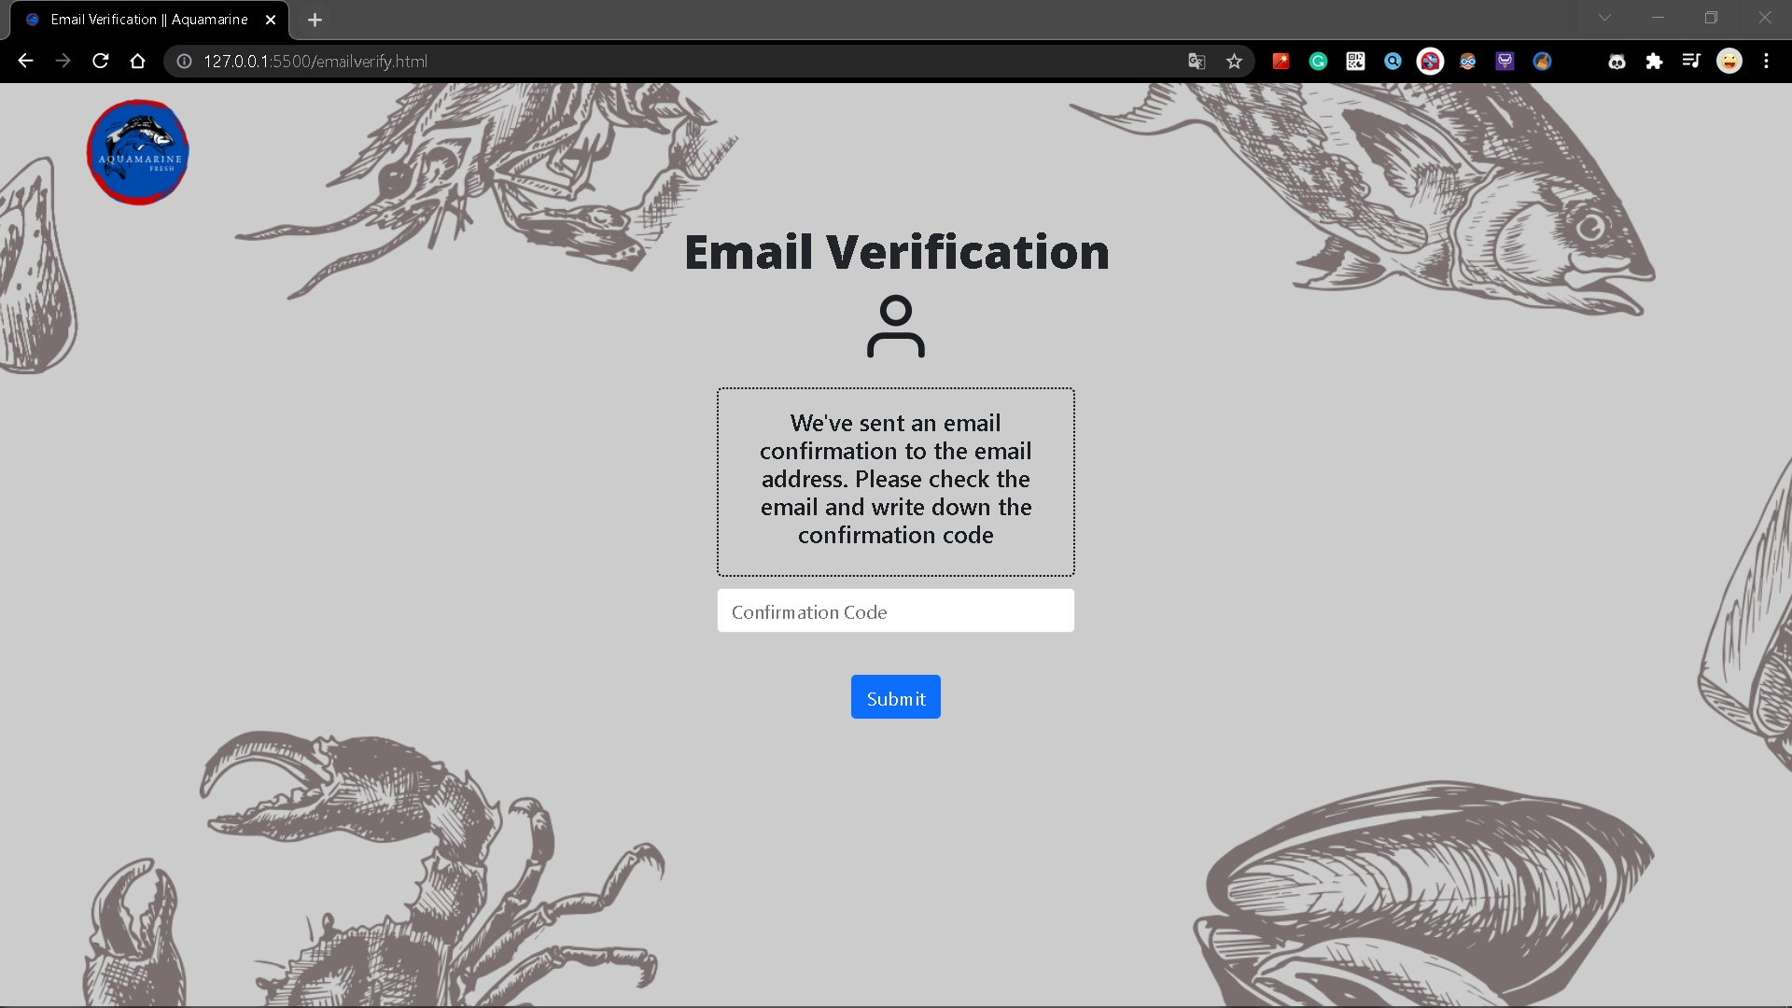
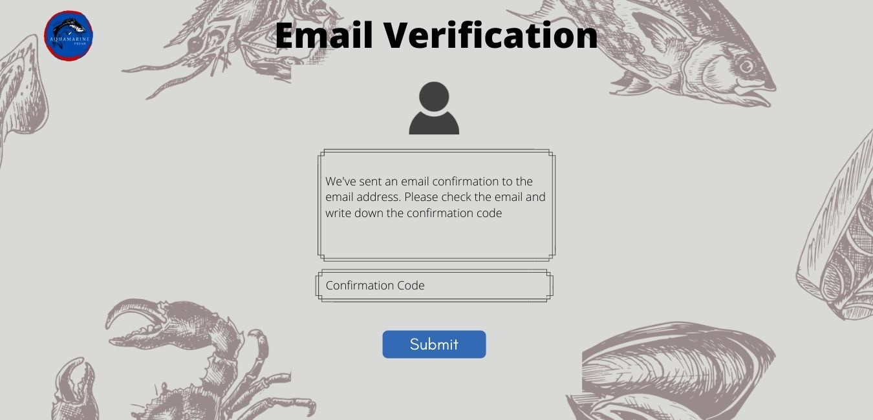
Halaman Email Verification
Design
Web
Perbedaan layout pada input box
Button Submit diubah dari nge link ke Home menjadi ke Change Password

Slide 27
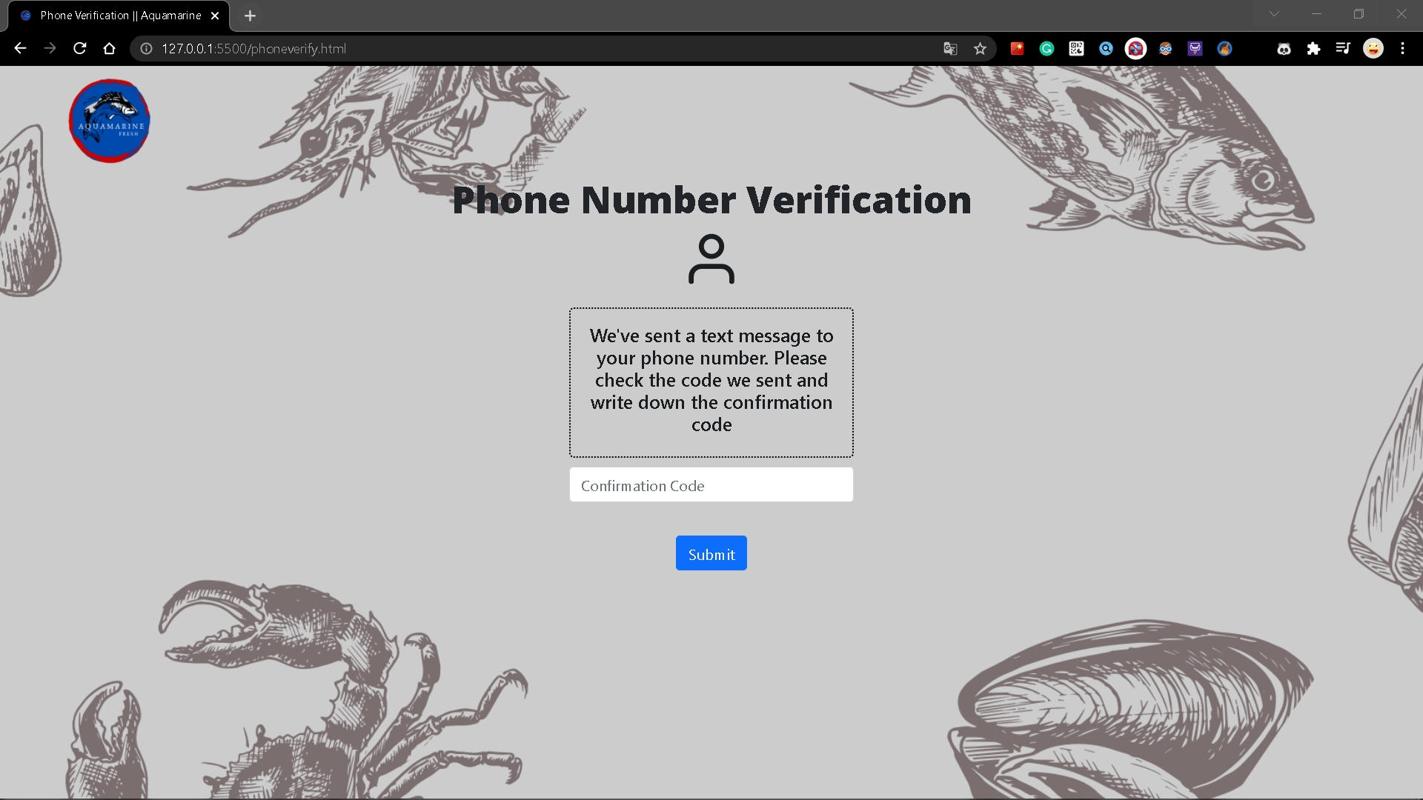
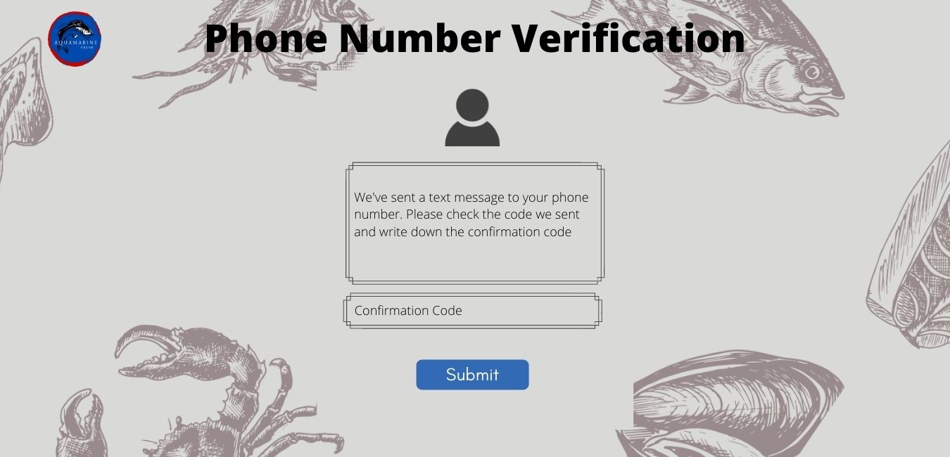
Halaman Phone Verification
Design
Web
Perbedaan layout pada input box
Button Submit diubah dari nge link ke Home menjadi ke Change Password

Slide 28

Halaman Change Password

Slide 29
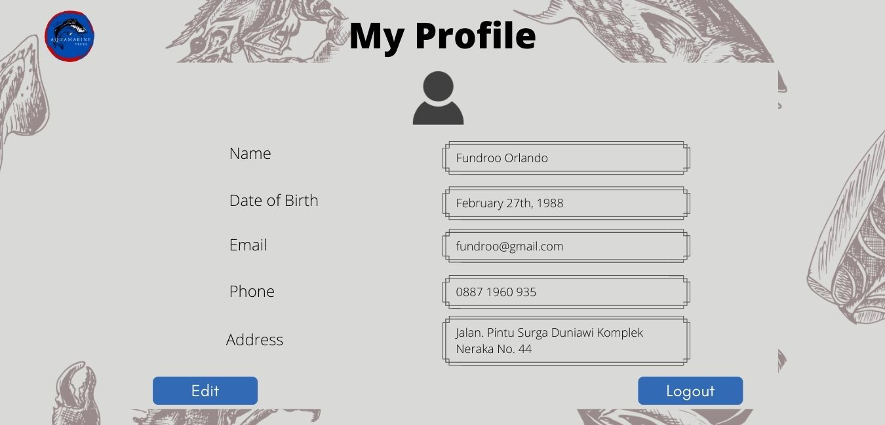
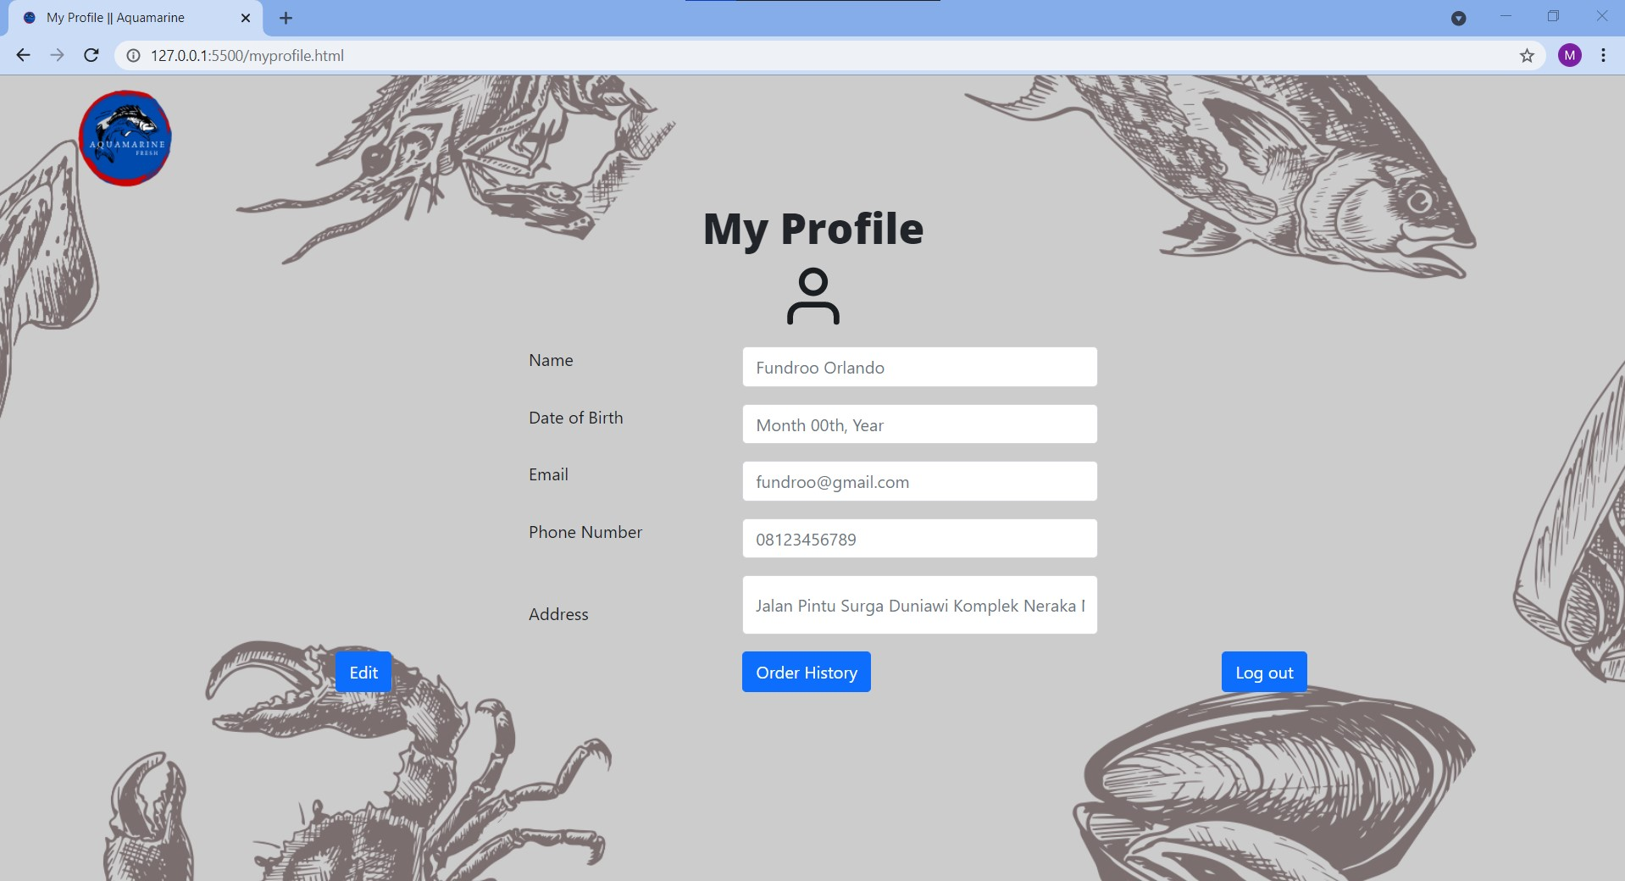
Halaman My Profile
Design
Web
Perbedaan layout pada box
Terdapat button Order History

Slide 30
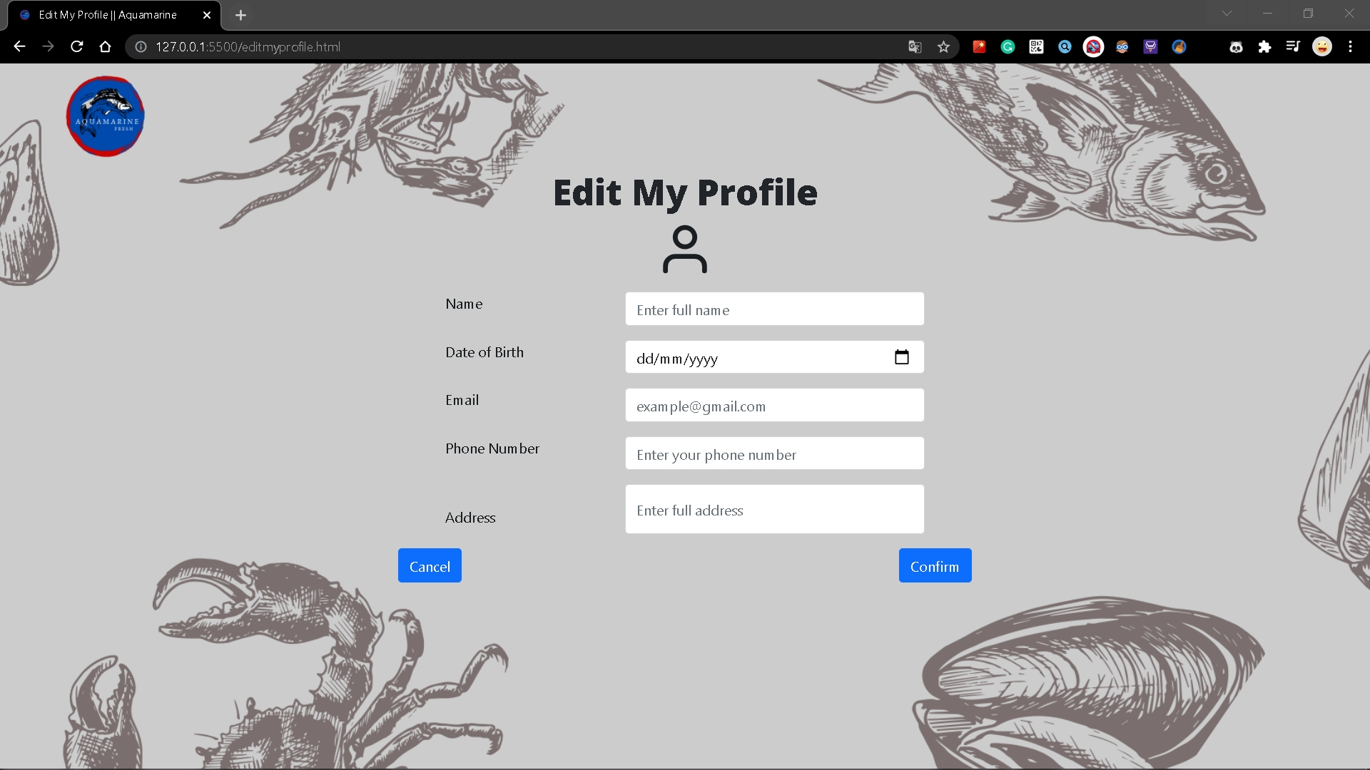
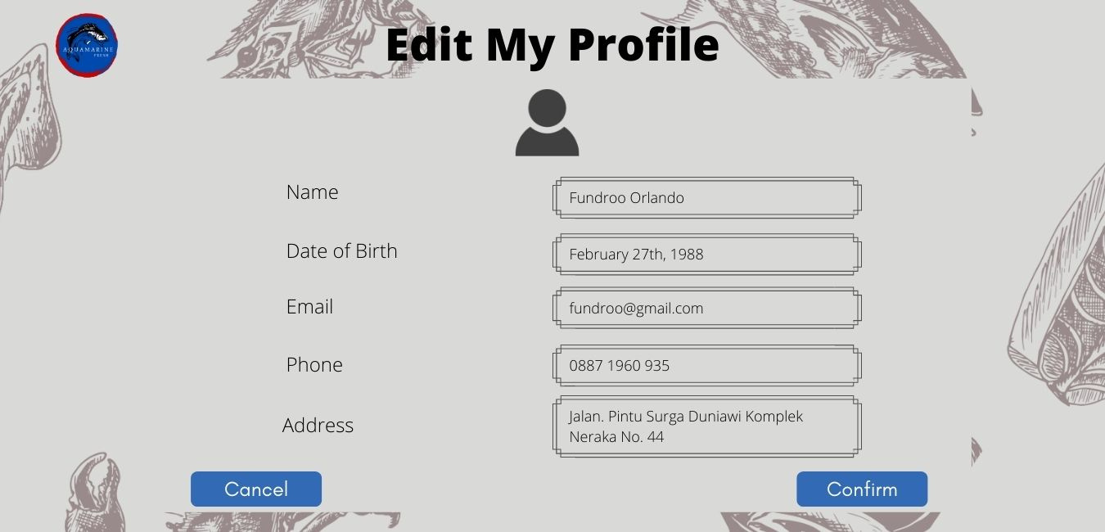
Halaman Edit My Profile
Design
Web
Perbedaan layout pada input box

Slide 31
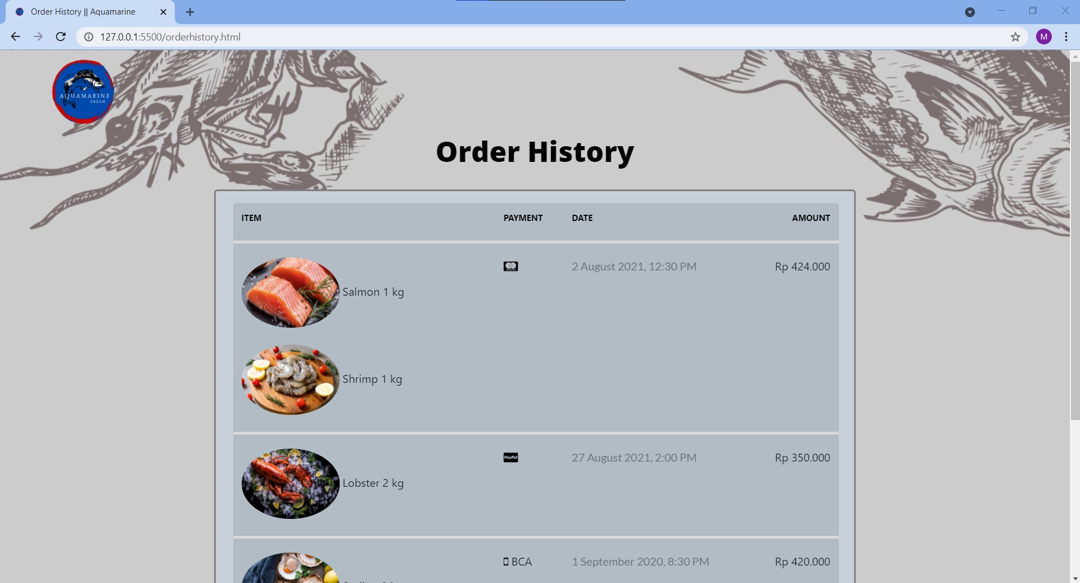
Halaman Order History

Slide 32

02
alur proses perpindahan halaman

Slide 33

NAVIGATION BAR
LOGO
01
Click HOME
to HOME section
Click CATEGORIES
to CATEGORIES section
Click PRODUCTS
to PRODUCTS section
02
Click Logo
back to Home
NAVIGATION BAR
Click ABOUT US
to ABOUT US section
Click GALLERY
to GALLERY section
Click CONTACT US
to CONTACT US section
03
SEARCH BAR
04
Click Search
type to Search Something

Slide 34




05
06
CART
PROFILE
else
choose My Profile or Wish List or Logout
if (My Profile) then
to My Profile (new page)
else if (Wish List) then
to Wish List (new page)
else
return to Home
Click Profile icon
if (haventLogin()) then
choose Login or Sign Up
if (Login) then
to Login (new page)
else
to Sign Up (new page)
Click Cart icon
to Cart (new page)
MENU BAR (RESPONSIF)
SLIDESHOW
07
08
Click Menu Bar
show Navigation Bar
Click Slideshow
to Products List (new page)
if (clickNextIcon) then
to New Slideshow
SEE WHAT’S NEW
Click See What’s New
to Products section

Slide 35

ABOUT US
PRODUCTS
Click on Map
Slide Map Location
09
10
Click Product
to Product Details (new page)
Click See Other Product
to Products List (new page)
CONTACT US
Click on Instagram
Link to Instagram Page
Click on Email
Mail to Email Address
Click on Button
Appears form
FOOTER
PRODUCT LIST
Click on Logo
Back to Home
Click on Location icon
To Google Maps
Click on Links (Home, Categories, Products, About Us, Gallery, Contact Us)
to each section of them
11
Click Search
type to Search Something
Click Product
to Product Details
Click Love Icon
Change color to red
add to Wish List
12

Slide 36

PRODUCT LIST
PRODUCT DETAILS
13
Click Search
type to Search Something
Click -
Quantity decrease
Click +
Quantity increase
14
Click Cart
add to Cart
Increase Your Cart
Click Your Cart
to Cart (new page)
PRODUCT DETAILS
CART
15
Click on Product
to Product Details
Click on Love Icon
add to Wish List
Click X Icon
remove from Cart
16
Click Add to Cart
add to cart
Click Buy Now
to Checkout (new page)

Slide 37
CART
CART
17
18
Click Quantity Box
adjust Quantity
Click Checkout
to Checkout (new page)
Click Wish List
to Wish List (new page)
Click Continue Shopping
to Products List (new page)
WISH LIST
Click Product
to Product Details (new page)
Click + Icon
add to Cart
Click X Icon
remove from Wish List
WISH LIST
19
20
Click Quantity Box
adjust Quantity
Click Add All to Cart
add to Cart

Slide 38
CHECKOUT
CHECKOUT
22
21
Click Change Address
appears pop up message
click Add new address
to Add New Address (new page)
Click Shipping Options
choose shipping option
Click Checkout
if (haventChoosePayment) then
to Payment (new page)
else appears pop up message
Click Choose Payment
to Payment (new page)
NEW ADDRESS
PAYMENT
23
Click First Name
type your First Name
Click Last Name
type your Last Name
Click Address
type your Address
Click Country
choose Country
Click Credit Card
type your Card Owner Name
type your Card Name
type Expiration Date
type CVV
click Confirm Payment
appears pop up message
click OK
to Checkout (new page)
24
Click City
type your City
Click State
type your State
Click Continue
back to Checkout
(new page)

Slide 39
PAYMENT
PAYMENT
25
26
Click PayPal
choose PayPal Account Type
click Log Into My PayPal
pay from your PayPal Application
Click Net Banking
choose Bank
click Proceed Payment
pay from your Net Banking Application
LOGIN
28
Click Username or Email Address
type your Username or Email Address
Click Password
type your Password
Click Login
back to Home
Click Click here
to Forget Password (new page)
Click Sign Up
to Sign Up (new page)
PAYMENT
27
Click E-Money
choose E-Money Type
click Proceed Payment
pay from your E-Money Application

Slide 40
SIGN UP
Click Username
Type your Username
Click Email Address
type your Email Address
Click Password
type your Password
Click Confirm your password
Type your password
SIGN UP
29
Click Full Name
type your Name
Click Phone Number
type your Phone Number
Click Choose Country
choose Country
30
SIGN UP
FORGET PASSWORD (1)
31
32
Click Full Address
type your Address
Click Sign Up
to Login (new page)
Click Login
to Login (new page)
Click Enter your username
type your Username
Click Enter your email address
type Something

Slide 41
33
34
FORGET PASSWORD (1)
FORGET PASSWORD (2)
Click Next
To Confirmation Page (new page)
Click Login
To Login (new page)
Choose Confirmation by Email Address or Confirmation by Phone Number
if (Confirmation by Email Address) then
confirmation code will be send by Email
to Email Verification (new page)
FORGET PASSWORD (2)
36
35
EMAIL VERIFICATION
else if (Confirmation by Phone Number) then
confirmation code will be send by Message
To Phone Verification (new page)
Click Login
to Login (new page)
Click Confirmation Code
type the code
Click Submit
to Change Password (new page)

Slide 42

PHONE NUMBER VERIFICATION
CHANGE PASSWORD
37
Click New Password
type your New Password
Click Confirm New Password
type your New Password
Click Submit
to Login (new page)
38
Click Confirmation Code
type the Code
Click Submit
to Change Password (new page)
MY PROFILE
EDIT MY PROFILE
40
Click Edit
to Edit My Profile (new page)
Click Order History
to Order History (new page)
Click Log Out
back to Home
profile will be log out
39
Click box
type something
Click Cancel
back to My Profile (new page)
Click Confirm
back to My Profile (new page)
My Profile changed

Slide 43

41
ORDER HISTORY
Click Product
To Product Details (new page)
AQUAMARINE

Slide 44


Thank You

